Slide 1
The Library Bill of Rights
“Librarians and library governing bodies have a public and professional obligation to ensure that all members of the community they serve have free, equal, and equitable access to the entire range of library resources regardless of content, approach, or format. This principle of library service applies equally to all users, minors as well as adults. Lack of access to information can be harmful to minors. Librarians and library governing bodies must uphold this principle in order to provide adequate and effective service to minors.”

Slide 2
A Patron is a Patron
We all serve everybody, no matter their age. You don’t have to be an “expert” to give good customer service to youth and teens.

Slide 3
Kids in the Library

Slide 4
Situation:
“Where’s my mommy?”

Slide 5
The crying child.
*Reassure the child. Get on their level and speak soothingly.
*Ask child to describe their caregiver, but keep in mind the description may not be particularly helpful.
*Accompany the child to look for their caregiver. Handholding may be appropriate in this case. Enlist security and other staff as necessary.
*If child is genuinely abandoned at the library - call PIC and/or police.

Slide 6
2. The escapee.
*Approach child and greet in a nonthreatening manner.
*Ask, “Are you here with someone? Can you show me where they are?”
*The child may flee from you. If so, follow discreetly. They may be going to their caregiver.
*Tell caregiver where you found the child, and gently suggest keeping a closer eye on them.
Notes:
Redirect - kid did not want to go back and was making for the stairs. I showed him the DVD’s I was carrying and asked if he’d like to help me put them up on display. That got him back to the children’s room, where his dad was.

Slide 7
Situation:
“You’re a mind reader, right?”

Slide 8
The misunderstood assignment.
*Repeat the question in your own words. Ask for clarification - “So, you’re looking for books about the Civil War? Are you interested in the battles, famous people, issues like slavery...”
*As the child looks at materials, they may remember more about the assignment. Invite them to come back to the desk with more questions, and follow up with them in a few minutes.
*Remember the databases!

Slide 9
2. That book with the cat and the blue fish on the cover and the frog...
*Use your reference skills - Ask the child to tell you what they do remember about the book. Repeat the question in their own words. Show them cover images to see if that jogs their memory.
*Redirect - “You know, I’m not sure if we have that Spider-Man book, but here are the ones we do have. Look at them and let me know if you don’t find one you like.”
*Try to send them away with something - don’t just say “We don’t have it.”

Slide 10
Situation:
“Wheee!”

Slide 11
Hooliganism!
*Give constant reminders, but not endless warnings.
*Frame behavior positively: “Walk please!” instead of “Don’t run!”
*Use the 5-step method - with modifications.
*Clarity of enforcement and expectations - make sure your whole staff is on the same page.
Notes:
Ask - sometimes with kids, especially young kids - being direct is better.
Explain why
Present options - be very clear here. At this step, you may need to involve the child’s parent, depending on age and situation.
Confirm decision
Act

Slide 12
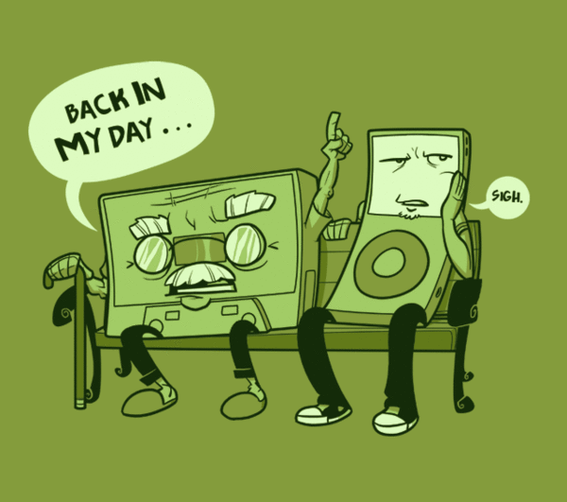
Situation:
“In my day, libraries were quiet, kids never talked back, and gas was only $1.50 a gallon.”

Slide 13
When adult patrons want to police kids’ behavior.
*Remind the adult patron that it is your job to take care of behavioral issues, but thank them for bringing their concerns to you.
*Make sure to enforce computer session limits fairly. Every patron has a right to use the public computers, whether for work or play.
*Make sure to enforce policies fairly. Think - “Would I reprimand an adult for this behavior?”
*Think about the purpose of different spaces and appropriate noise levels for those spaces. Is there a quiet space to direct people to?
Notes:
A children’s space will be louder than other areas. Often computer areas are the busiest and loudest parts of the library. Do you have a more quiet reading/study space you can direct people to, and circulating devices for them to use there?

Slide 14
The Cardinal Rule - Engage!
*Talk to kids about what they’re interested in. Listen to them and ask questions. Like everyone else, kids just want to be heard!

Slide 15
Teens in the Library

Slide 16
The Teen and The Library
How they are different.
The Teen Brain
They are boundary testers! This makes them an at-risk population regardless of external factors.
They decipher your body language signals differently. This can lead to major misunderstandings
How to engage them and why you care.
...with a smile and a genuine desire to be of assistance.
It’s good for business. (social media and the sharing of bad experiences)
They can become “confident, knowledgeable, goal-oriented and successful” adults/parents/caregivers/teachers.

Slide 17
The Assets Libraries Can Support
Adult Relationships.
Young person receives support from three or more non-parent adults.
Caring Neighborhood.
Young person experiences caring neighbors. -it’s important that they not feel excluded by our spaces or materials.
Safety
Young person feels safe at home, in their neighborhood and community.
Reads for pleasure.
Young person reads for pleasure for three or more hours per week.
Neighborhood Boundaries
Neighbors take responsibility for monitoring young people’s behavior.-This DOES NOT mean babysitting.
The Whole Library Handbook:Teen Services Edited by Heather Booth Karen Jansen

Slide 18
Controlling Their Behavior
This is impossible and not our goal as a public library.
Teens are developing individual personalities and could view your need to control them as an aggressive challenge-you don’t want that.
We are not a school.
Our resources can and will be used by all of patrons for work and play.
Teens and youth like to just hang out. We are okay with this. We want this.
Give them a space where this appropriate. Protect this space as theirs.
Again. Enforce the rules in the space fairly and consistently.
So...we don’t control their behavior. We guide it.

Slide 19
...but sometimes they get out of hand.
Our Customer Code of Conduct lists behaviors that are prohibited in the library-for all patrons. “Failure to [comply] may result in expulsion from the library and/or the loss of library privileges.” So what can you do in these common situations?
PDA-Engaging in ... acts of public indecency
Noise*-Making loud or disturbing noises
Profanity-Using obscene or vulgar language
Bullying-Harassing customers or staff
Correct the behavior. Give them a chance to change the behavior. Follow through with consequences if change isn’t made.
Unlike children, teens do not need to be repeatedly reminded. A clear expectation communicated once is enough.

Slide 20
Reader’s Advisory Tips
Teens will not usually come to you. So what do you do when you want to talk shop?
Rove. You will find them in the stacks.
Utilize paper and visual materials.
“Just to give you an idea of what we have, all of these are new.” or “This display features adventure/love/horror.”
When they do come to you.
They are usually looking for something specific. School related or a certain title.
Use this opportunity to promote your programs and services!
Our programs our expertly designed to promote learning, creativity, social skills and a whole bunch of other positive stuff.
The HUB! (for our more ambitious employees)
Leave the door open for more communication.
Let me know if you need anything else.

Slide 21
Research and Schoolwork
Ask a lot of questions.
Is this for school?
What are your assignment requirements?
How long do you have to complete the assignment?
Know what we offer!
Databases
Teen Volunteer opportunities

Slide 22
Questions?

