Slide 1
Summer Reading 2020
The Crash Course

Slide 2
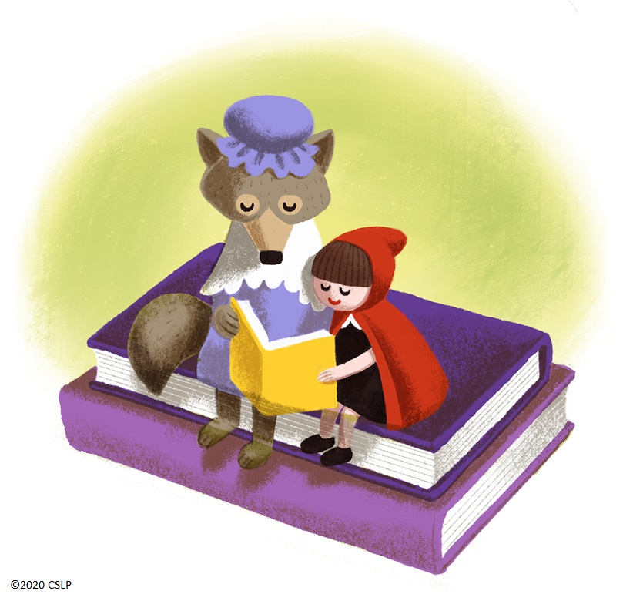
Registration and Tracking

Slide 3
Patron-Side Registration: https://www.pueblolibrary.org/summerreading
*Select age
*Click “Join Here”
*Fill out information
*You’re done!
Notes:
Go to screen-share

Slide 4
Patron-side Tracking
*Can be accessed from “Home”, or add new time to existing entry in “Books”
*Tracking is in minutes only
*Wandoo does not have an app, but the site is decently user-friendly on a mobile device.

Slide 5
Staff-Side Registration: https://pueblocitylibrary.evanced.info/
*Select age
*Click “Register Now”
*Fill out info
*You’re done!
Notes:
*Screen share

Slide 6
Staff-side Tracking:
*Go to “Find Patron”
*Enter patron name
*Select “Add Entry”
*Note: Tracking prize redemption can only happen on the staff side.

Slide 7
Family Tracking
On the patron login screen, click “Enter Family Management Portal” and “Join Here”
Any child signed up with the same email address as the parent will be automatically linked to the account owner.
To track reading, scroll to the child’s name, click the green arrow, and click “View Details”
Click “Books” - time can be tracked here - for multiple children simultaneously.

Slide 8
What about paper trackers?
We provide paper tracking sheets for two reasons:
*To supplement digital tracking for families where it will work better. (In this case, families transfer physical to digital tracking themselves.)
*To open the program to families without reliable internet access. (In this case, families will give us their trackers and staff will transfer the info to digital records.)

Slide 9
Paper Tracking Process - Phase 2
*Patron can call in and staff will track reading for them over the phone.
*If patrons drop off trackers in the bookdrop - quarantine them for 3 days before processing.
*If patrons want to hand you a tracker in person - if you have a walk-up table, have an envelope or box there for patrons to put trackers into. If not, ask patron to wait and bring an envelope for them to drop the tracker into. Infor them trackers will be held for 3 days before processing.

Slide 10
Paper Tracking Process - Phase 3
*Have an envelope or drop box at the service desk. Inform patrons that trackers will be held 3 days before being processed.
*Alternatively - patrons could tell you their name and how many minutes they read, while you enter it into the tracker. That would allow for faster prize awarding, if applicable.

Slide 11
Prizes

Slide 12
Prize Schedule
“Challenges” - One free book per month
0-12 = 150 minutes
13-18 = 300 minutes
In August - for ages 0-12, free book will be accompanied by medal
*Note: Challenges are only active for one month. Unlike previous programs, patrons cannot back-fill reading, eg., they cannot receive a June book for reading done in July.

Slide 13
How do we give people the book?
Curbside Pickup - By Phone
Patron calls - in Rawlings, forward this call to YS.
Ask if they want a randomly-selected book, or would like the list.
Send list by email and ask patron to reply with decision, OR
Mediate the list over the phone. Ask for favorite genres, subjects, etc. and describe the books in those categories.
Arrange curbside pickup.
In Person - Phase 3 forward
YS desk and Branch desks will have laminated lists by age category.
Ask patron to choose from the list, then give them the book.
Sanitize the laminated list.
*Note: In each case, make sure to track that the prize has been “Awarded”

Slide 14
Prize Schedule
“Awards” - Grand Prize Entry
Every interval = one entry (150 minutes for youth, 300 minutes for teens)
Weekly Drawing - First drawing Monday June 8, then each Monday until August 17
One for youth, one for teens - gift certificate to a local business
Email or phone number must be provided to win!
Final Drawing - end of August
Teens only - backpacks

Slide 15
Book Prize Lists
The complete list - https://drive.google.com/file/d/1OOOi0cLuuP_IDGcGYVqRL4ThWUsjlwjp/view?usp=sharing
Children (0-8) - https://drive.google.com/file/d/1oozSzf_Ee_84eGj4WW39ZY1Ht1oexOsA/view?usp=sharing
Tween (9-12) - https://drive.google.com/file/d/1ETmwhUBEh6FeEL9EULUiT3P6A978vL1m/view?usp=sharing
Teen (13-18) - https://drive.google.com/file/d/1BGbUdmbLLAJVYcDKybAtOJmFN1Hozwnh/view?usp=sharing

Slide 16
Programs

Slide 17
Virtual
*Streaming/Recorded performances throughout June and July.
*Interactive classes and workshops - These require registration. Evanced entries are up for these. Patrons and staff can register beginning June 1. Some will require supply pickup, which will be arranged by YS.
*Note: As of now, all in-person Summer Reading programs have been suspended through the end of July, including storytimes, clubs and hangouts.

Slide 18
Mon. and Thurs. | June 15 - July 16 | 11 a.m. | Music Together
Wednesday | June 17 | 11 a.m. | Wag That Tale!
Friday | June 19 | 11 a.m. | Fairies in the Cogwork
Friday | June 26 | 11 a.m. | Dr. Noize
Wednesday | July 1 | 11 a.m. | Javi the Dancing Monkey
Friday | July 3 | 11 a.m. | Yoga for Kids
Wednesday | July 8 | 11 a.m. | Folk Dances with the Colorado Ballet
Friday | July 10 | 11 a.m. | The Great Fairy Tale Myth-Tree
Friday | July 17 | 11 a.m. | Turnip the Beet on What Kids Eat
Friday | July 24 | 11 a.m. | The Tempest
Friday | July 31 | 11 a.m. | Dragons: Return of the Ice Sorceress

Slide 19
Wednesday | June 10 | 2 p.m. | Make a Zine
Thursday | June 11 | 2 p.m. | Acrylic Wall Art
Monday | June 15 | 2 p.m. | Wild Animation Workshop
Tuesday | June 16 | 2 p.m. | Watercolor Resist Dye
Thursday | June 18 | 2 p.m. | Arabic Calligraphy Workshop
Monday | June 22 | 2 p.m. | Chalkboard Wall Art
Tuesday | June 30 | 2 p.m. | The Whole Story with Adri Norris
Tuesday | July 14 | 2 p.m. | Turnip the Beet on What You Eat

Slide 20
Physical
*In-person performances are scheduled for the first two weeks of August.
*These are, of course, dependant on conditions at the time. Attendance may be limited.

Slide 21
Tuesday | August 4 | 11 a.m., 2 p.m. | BA, LU | Sound Ideas from Around the World
Wednesday | August 5 | 3 p.m. | GI | A Midsummer Night’s Dream
Thursday | August 6 | 10 a.m. | LA | Mad Science: Myths and Marvels
Thursday | August 6 | 2 p.m. | GHV | Fairy Tale Chemistry
Friday | August 7 | 10 a.m. | PW | Satrangi: Seven Stories of Light
Friday | August 7 | 2 p.m. | RA | Jazzy Festival Taiko
Tuesday | August 11 | 11 a.m., 2 p.m. | BA, LU | Frozen and Fiery Fairy Tales
Wednesday-Friday | August 12-14 | 3 p.m., 10 a.m, 2 p.m. | GI, LA, GHV, RA | The Comedy Juggling Professor

Slide 22
Summer Kits2Go - Youth and Tween/Teen
Accompanying a Curbside Hold
When someone places a hold for youth materials (picture books, chapter books, or teen books) and you arrange curbside pickup, ask if they would like program kits, for youth or tween/teen, and how many.
Pack kits with hold and deliver to patron at curbside.
Kit Request without Accompanying Hold
At Rawlings:
Route calls to YS.
YS staff ask what age of kits and how many.
YS staff arrange pickup separately from curbside holds pickup - there will be a designated kit pickup space in the parking lot, separate from holds pickup spaces.
At branches:
Depending on your hold volume, you may find it easiest to follow the Rawlings process, or to handle holds pickup and kit pickup using the same calendar, parking spaces, and staff.

Slide 23
Summer Kits2Go - Youth and Tween/Teen
Kits in Person - Phase 3 Forward
If a young person enters the library, ask directly if they would like a kit.
Have sign at desk advertising we have kits on request.
Keep a small box of kits on the desk for spontaneous pickup - ask patrons to take one per child/tween/teen they are picking up for. Monitor for potential abuse and enforce reasonable limits as needed.
SPECIAL NOTE: Phase 3 @ Rawlings
Until YS is open, kits will be given out at the Circ desk. When YS re-opens, Circ will ONLY handle kits for inclusion with curbside holds.
*All kits should also include a snack. YS will purchase snacks and send them to you.
*Note: For summer - please give out standard program kits provided by YS without adding your own materials. You know I love your creativity, but this will support a consistent patron experience and take some tasks off your plate in a summer where we’re managing a lot of changes already.

Slide 24
Youth Kits
June 8 - Stick Kit Craft Kite
June 15 - Mini Dinosaurs
June 22 - Animal Scratch Art Masks
June 29 - DIY Pinwheels
July 6 - Magical Wands
July 13 - Fairy Bells
July 20 - Clothespin Creatures
July 27 - Clay Mythical Creatures
August 3 - Jack and the Beanstalk
August 10 - Shrinky Dinks

Slide 25
Tween/Teen Kits
June 8 - Popsicle Stick Catapults (Video June 9)
June 15 - Manga Drawing
June 22 - Paracord Keychains and Shrinky Dinks (Video June 23)
June 29 - DIY Spa (Video July 2)
July 6 - Papercrafts/Origami (Video July 7)
July 13 - Milk Carton Bird Feeder
July 20 - Powerballs (Video July 21)
July 27 - Henna (Video July 28)
August 3 - Paper Circuits
August 10 - Friendship Bracelets

Slide 26
Books in the Park

Slide 27
Monday-Friday, 10-12
Monday-Wednesday at Bessemer
Parking lot next to the pool
Thursday-Friday at Fairmount
Morton drop-off lane

Slide 28
Drive-through/Walk-through Station
Patrons can get bags of picture books, chapter books, teen books, and adult books.
*Youth do not need to be present when an adult is picking up.
*Each bag will contain 3 books.
*All youth and teen bags will contain a snack.
*All youth bags will contain a craft.

Slide 29
Questions
*Wandoo - Maria Kramer
*Virtual programs and registration - Maria Kramer
*BIP - Maria Kramer
*Prize books/Medals - Angel Rathell
*Youth Kits - Kirsten Dees
*Tween/Teen Kits - Ciara Kehoe

