Slide 1

Hispanic
Resource
Center

Slide 2
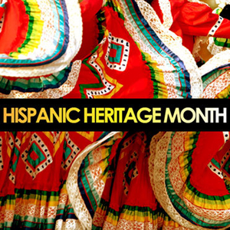

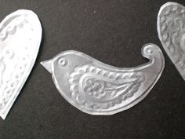
Hispanic Resource Center
The mission of the Hispanic Resource Center at the Rawlings Library is to provide services, activities and free resources for both Spanish and English speakers.
Our goal is to promote and enhance personal success through expanded educational and cultural opportunities not just for the Hispanic community but for the Pueblo community at large.

Slide 3

The Hispanic Resource Center Collection is floating!
Hispanic Resource Center in our branches
Due to language barriers and cultural differences of library usage, the materials in the Hispanic Resource Center will float. Each location will have a section for all materials with Spanish signage.

Slide 4
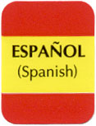
Evolution of Hispanic Resource Center’s Call #’s
A long time ago, all numbers were 460 on all Spanish Materials (Fiction and Nonfiction)
Our first HRC Librarian applied the Dewey Decimal Classification system for our Spanish materials. The call numbers were HRC Sp.
Our second HRC Librarian brought English materials that were about Hispanic culture in the United States and Hispanic authors and literature. The HRC was dropped and books that were in English and Spanish contained the call number SP.
Our first HRC Coordinator brought stickers to identify materials that are in English, Spanish and Bilingual.

Slide 5
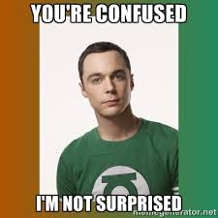
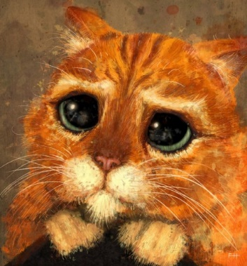
Confused?
We currently have 4 different classification systems in the Hispanic Resource Center.
Collection Development and I are working together to make this collection to have only one system.
This will take time………..please be patient.

Slide 6
New Call Numbers
Materiales en Español
Spanish Materials
Spanish sticker for items in Spanish
  Material is in Spanish?
    Call # for fiction HRC Sp Anaya
    Call # for nonfiction HRC Sp 152.41 P
    Call # for biography HRC SP BIO Fox
  Material is Bilingual?
    Call # will be HRC Anaya for fiction
    Call # will be HRC 323.623 U for nonfiction
    Call # for biography HRC BIO Fox
  Material is in English?
    Call # will be HRC Anaya for fiction
    Call # will be HRC 331.627G for nonfiction
    Call # for biography HRC BIO Fox
Bilingual sticker will still be used.
Hispanic sticker will eventually be retired.

Slide 7

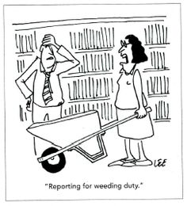
What to do with weeded items from the Hispanic Resource Center?
Please send them to Maria
What does Maria do with these items?

Slide 8
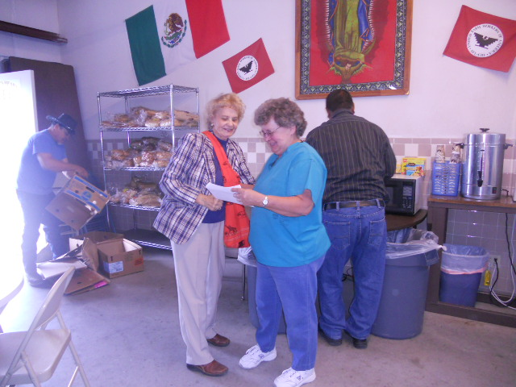
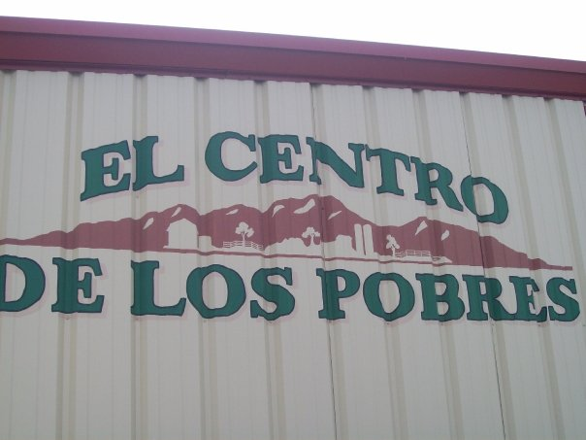
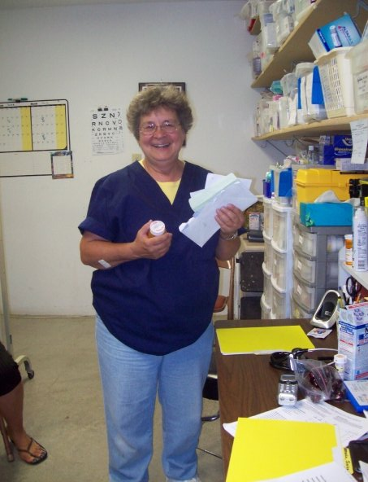
Donations for El Centro de los Pobres
This center serves over 5000 migrant families a year.
Sister Nancy Crafton is the heart of the operation.

