Slide 1
Creating Consistency for fine disputes
Forgive or Cancel late charges: who can, how much, and for what reasons.

Slide 2
Goal
Customers often approach staff and management requesting that their fines or charges for lost items be taken off of their account. This is a great opportunity for the library employee to be empathetic to the customer, but it could also be a sticky situation because we need to apply the fine policy fairly.
These fine waiving guidelines were developed to help improve consistency across the district, and assist employees and managers consistently apply the fine policies.

Slide 3
What is actually happening –

Slide 4
Fine % Goal
Branches should have a goal of Cancelling and Forgiving in the 15-10% range.
We don’t want to be too strict nor too lenient.
Rawlings waives might be slightly higher due to referrals from the other branches, and will aim for the 25-20% range.

Slide 5
Results of Fine Survey
Circ Task Force and Public Service Managers were surveyed
Most agreed that Staff should be able to forgive and cancel around $5
Majority agreed that Managers should be able to forgive and cancel around $20

Slide 6
What are reasons to mark it fORGIVEN?
Example of Forgiven (customer “fault”)
Learning Curve – The customer expresses frustration that they didn’t know the rules.
Family emergency – Death, Hospitalization, Illness
Identity theft – customer claims not to have checked out material (give them new card & explain in future if they loose card, must contact library right away).
Juvenile now adult – Juvenile claims their parent ran up fines on their card
Bad Weather – Severe weather kept them from returning items (explain renewal process available over phone and online)

Slide 7
What are reasons to mark it cancelled?
Example of Cancelled (library fault)
Customer claims they asked staff to renew – update customers account information, explain to them about our library elf service
Item found on shelf
Failure to backdate
Claims they had previously paid fine.

Slide 8
Staff can forgive or cancel up to $5
Show empathy for their point of view. “I hear that you believe this fine is not your fault, let me look at your account to see what I can do”
Review the history of paid fines and notes, so you can have a better understanding of what is going on with the account. If there is a history of fine waiving then refer to a Manager. “It seems we have previously waived fines, if you want this fine waived you will need to speak to my manager. I can check out 2 items to you, but you will need to contact them before your next checkout.” (make sure to notate acct that you allowed 2 checkouts)
Staff can forgive or cancel a maximum of $5. Explain to them a way to avoid this in future, and remove charges. Example “2/14/14 customer couldn’t return items because of ice on the road. Forgave $5, and explained phone or online renewal system. Kbarnett/ra”
If they want more than $5 removed refer to manager by having them fill out customer resolution form, and give form to your Manager.

Slide 9
Manager can forgive or cancel any amount over $5
Manager can take off up to $20 for any reason given by customer, but make sure to put a note on their account, and explain a way for them to avoid that circumstance in the future.
If fine is more than $20 and includes lost items ask for documentation like a hospital bill or a police report. If they say their card was used fraudulently ask them to fill out a police report and bring that to you.
Do not waive the $10 referral fee unless it was the library’s fault.
If feel uncomfortable or there is a fine waiving history then refer to Circulation Manager.

Slide 10
How to remove charges
Choose Paying
Bills in Sirsi
Type in amount, and then select forgive or cancel in drop down menu. Don’t use if amount will go into a collection fee. If so, then use the individual payment options below.
Type in card #

Slide 11
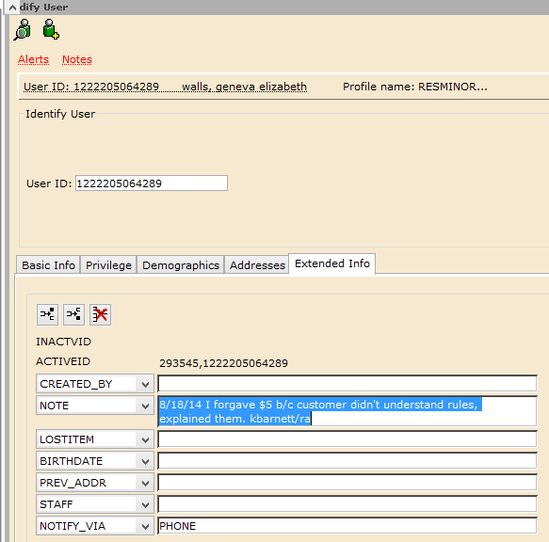
Notate the account
If you forgive or cancel for any amount always put a note in the account.
Always read the notes before agreeing to waive a fine.
Go to Modify User, click Extended Info tab, and type in box next to Note. Start with the date, and end with your initials.

Slide 12
Updated Circulation Module on fine waiving
Our ability to handle fines in a calm and flexible manner is a critical element in the way customers will perceive the services offered by the library. Staff can forgive or cancel up to $5 if the customer feels the fines were unjust. Examples of circumstances in which you may choose to FORGIVE a fine include identity theft, severe weather, illness, hospitalization, death of a family member, juvenile now adult, or lack of knowledge. Examples of circumstances in which you may CANCEL a fine include PCCLD technology issues, failure to backdate, previously paid, and asked to renew. Refer to a Manager if customer wants more than $5 waived, and do not remove collection agency REFERRAL fees unless it was library’s fault.
After empathizing with their circumstance, and removing fines explain a way for them to avoid that in the future like our library elf system, online renewals, or our loan rules. If you do this, please note the account in the following manner: “2/15/14 Forgave $5 for dvds returned late. Ice on the road. Explained phone and online renewal system. kbarnett/ra.”

