Slide 1
Issuing Library Cards
New & Replacements

Slide 2
Requirements for a Card
Picture ID
Proof of Address

Slide 3
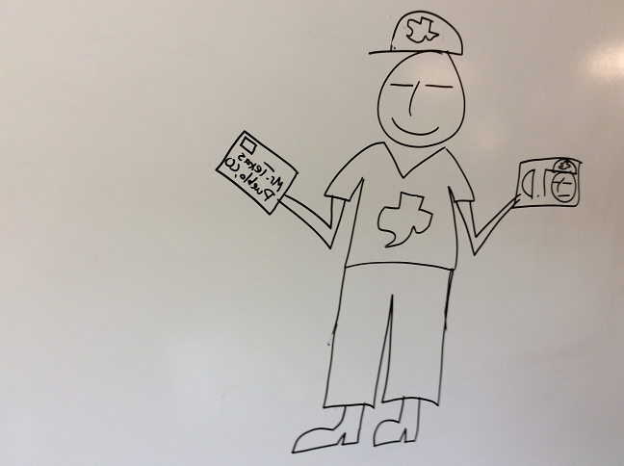
Always Check For Previous Accounts!

Slide 4
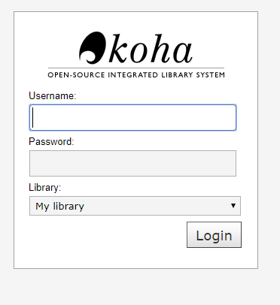
Log into Staff Koha
STAFF
https://staff-pueblopl.bywatersolutions.com
Username: first initial last name
Password: 8 digit DOB
Choose whatever branch
you’re working at!

Slide 5
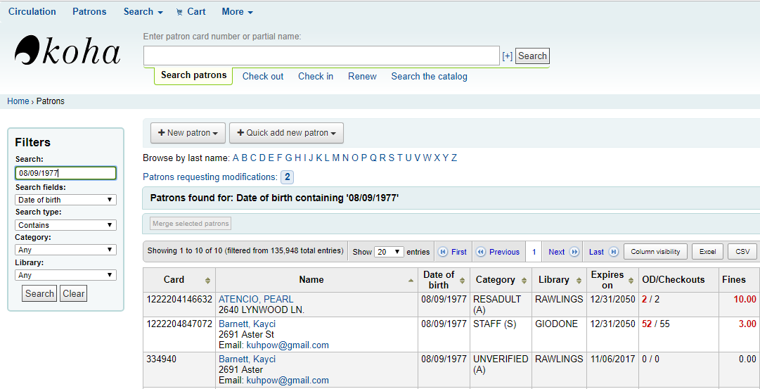
Check for a previous account

Slide 6
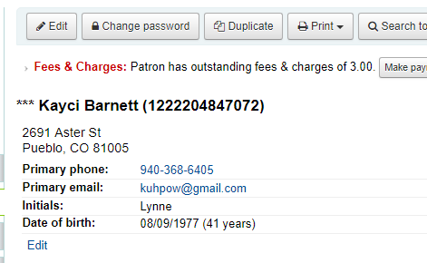
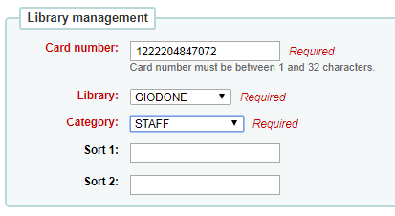
If previous acct. found…
Click edit, and verify all information is correct including address, phone #, and notice preferences.
Scan new barcode into card # field.
Make sure the category is correct,
most will be RESADULT.

Slide 7
If it is a new customer…

Slide 8
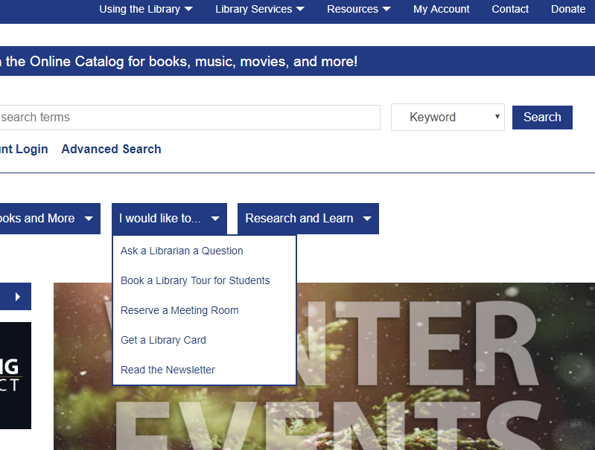
Registering for a new card online
Go to pueblolibrary.org Then under I would like to… Choose Get a Library Card

Slide 9
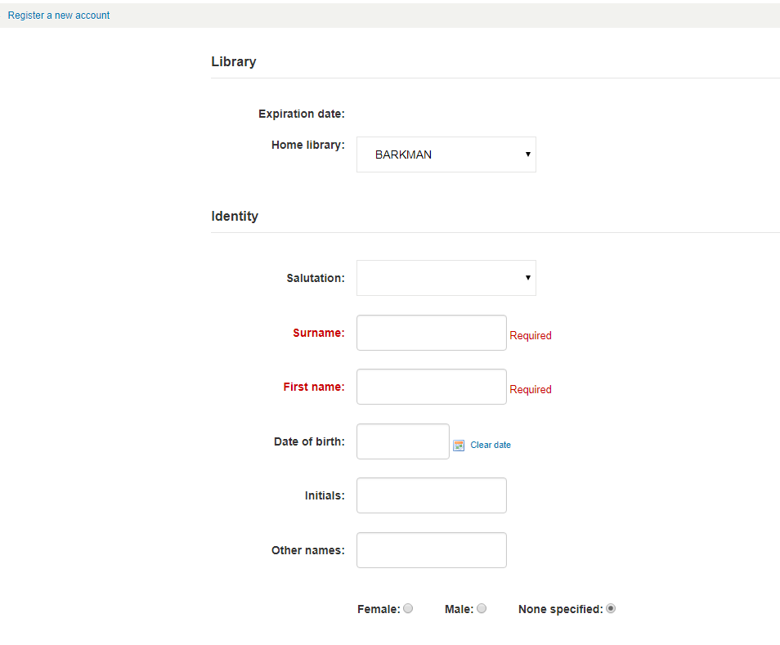
Registering for a new card online

Slide 10
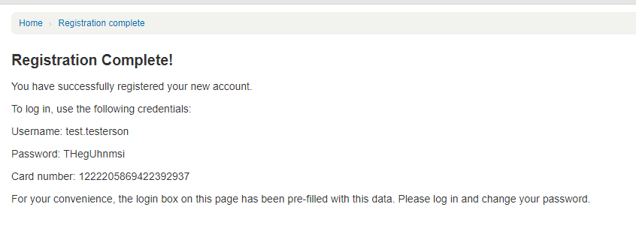
Temporary ID

Slide 11
Change the Profile type
When you change the status and save
It will automatically update the privilege length.
Scan in a library card
change the profile status

Slide 12
Profile Type Resident Adult/Minor
Resident- Reside or own property in Pueblo County.
RESADULT -Customers 18 years of age and older
RESMINOR - Customers 17 and younger.

Slide 13
Profile Type Nonresident Adult/Minor
Nonresident - Customers who live outside Pueblo County, but within Colorado. They cannot access downloadable content (ebooks) and certain licensed databases, and are not eligible for Interlibrary Loan services.
NONRESADLT – Over 18
NONRESMNR– Under 17

Slide 14
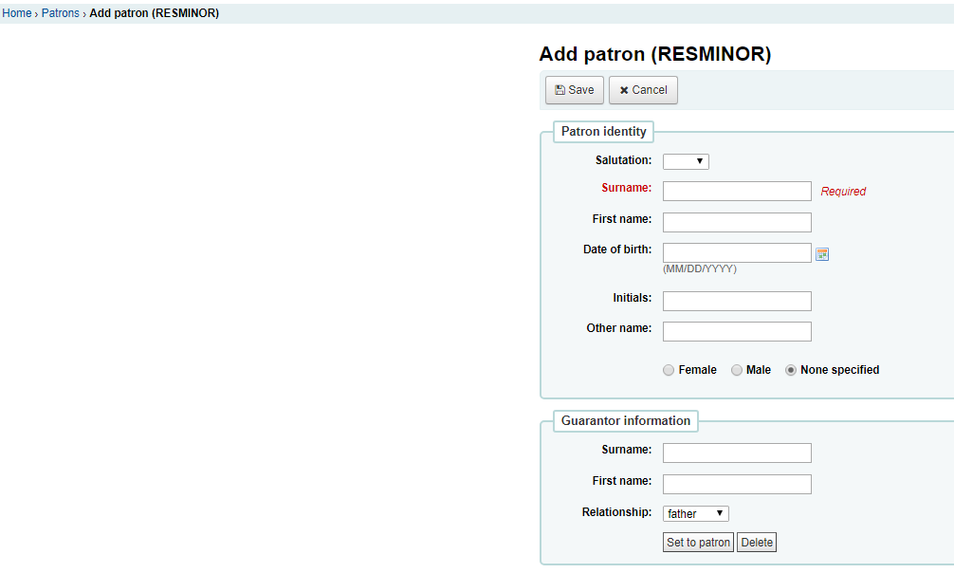
Minors Only
Ask the adult with them if they are the parent or guardian, and will take responsibility for the acct.
Check their parent’s acct, if over $10 in fines do not issue a new acct.
Put the parent’s name in the Guarantor Information.
parent’s name

Slide 15
Profile Type Unverified
proof of address was not provided at the time of registration
there are issues with the account and staff have changed the account status.
Allows the customer to check out two items at a time and access to some library services may be limited. The privilege expires 30 days from the registrations date.

Slide 16
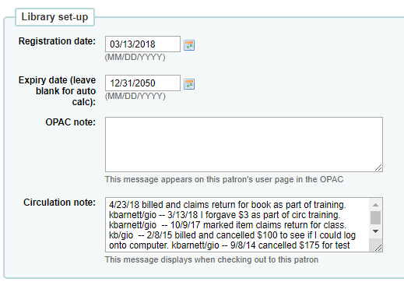
Add Notes
Patron can see
Staff can see

Slide 17
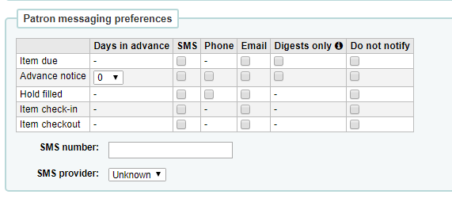
Update Notice Preferences

Slide 18
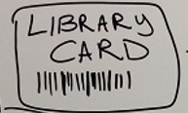
Welcome to the Library
Hand them a welcome brochure
have them sign the card
ask if you can help them find anything.

Slide 19
Loan Rules http://www.pueblolibrary.org/about/borrowingrules

