Slide 1
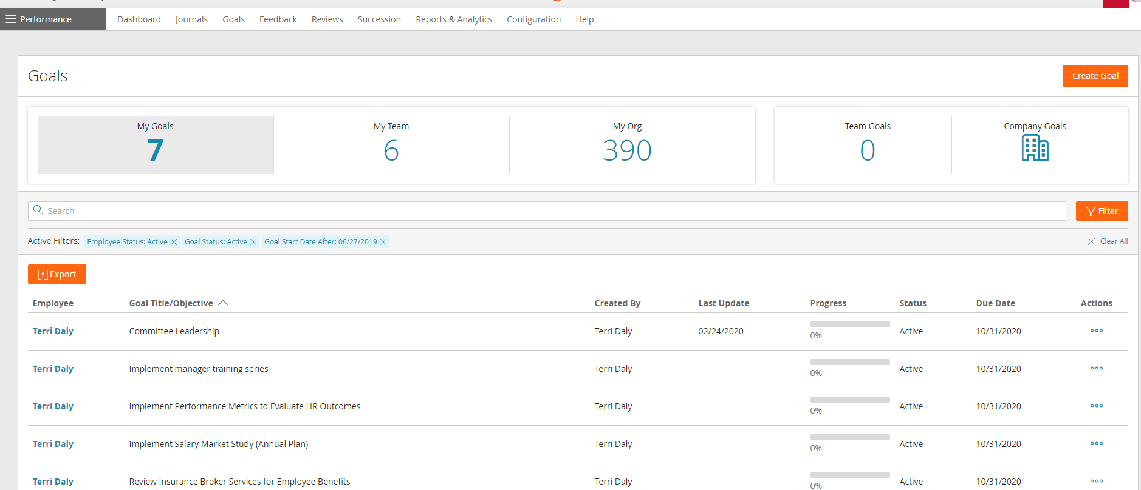
Completing and Removing Prior Year Goals
Managers: On the Performance Page, select Goals, then My Team.
Employees: Select My Goals
2. Notice the default Filters. Select Filter if you would like to change these.

Slide 2
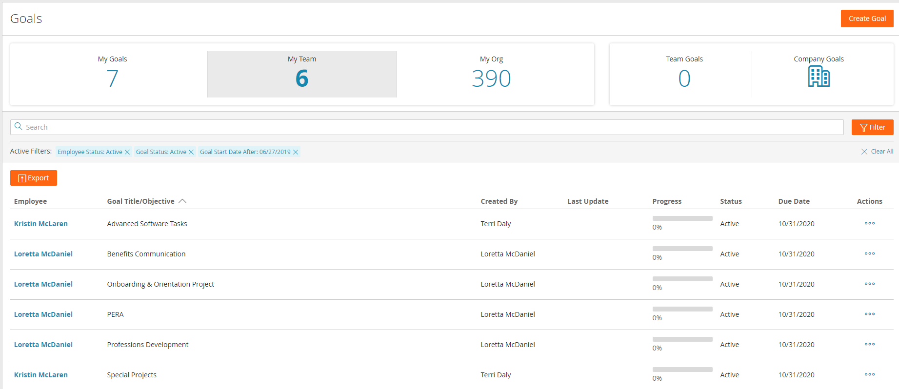
Completing and Removing Prior Year Goals
3. For 2024 and prior year’s goals, select the 3 dots under Action.
4. A pop-up window will display options.
Select Edit.

Slide 3
Completing and Removing Prior Year Goals
5. Select Actions.
6. From the drop down menu,
select Edit

Slide 4
Revising Current Goals and Completing/Removing Prior Year Goals
7. Under Status, select the arrow down, then select Complete – Attained or Complete - Missed
8. SAVE!

