Slide 1
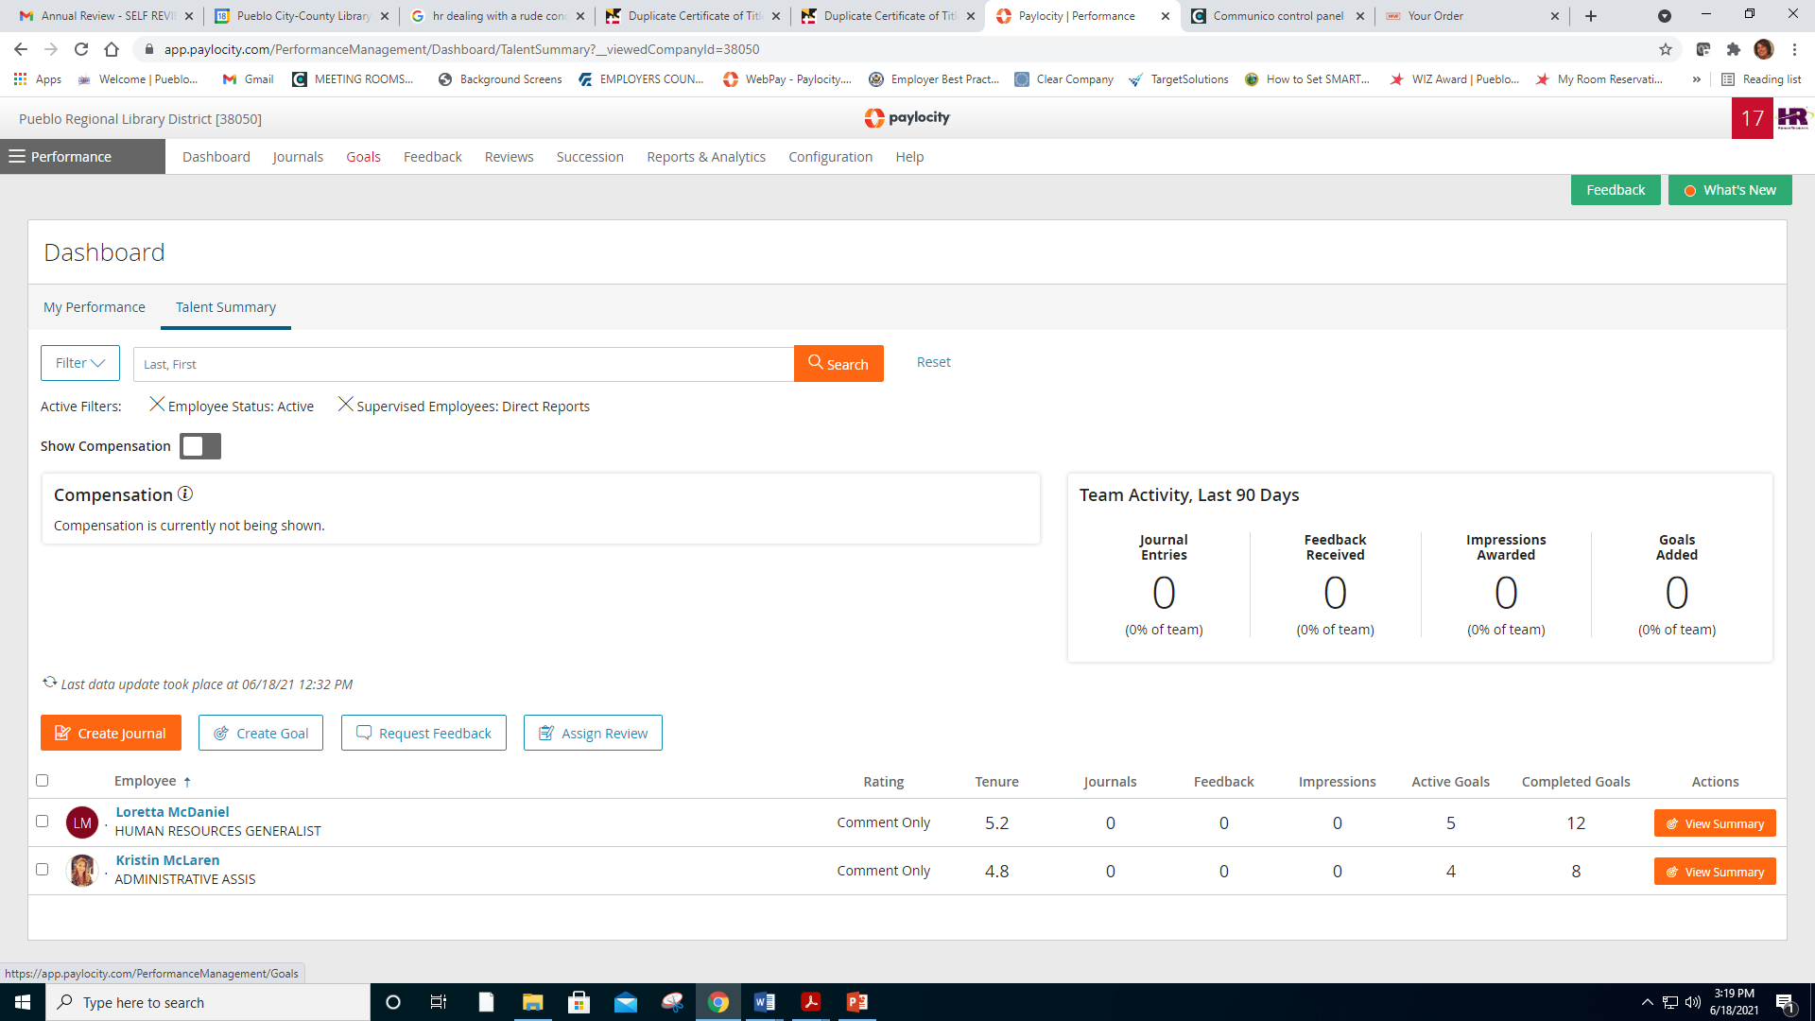
2025 - Adding Goals – How To
Select Performance
Select Goals

Slide 2
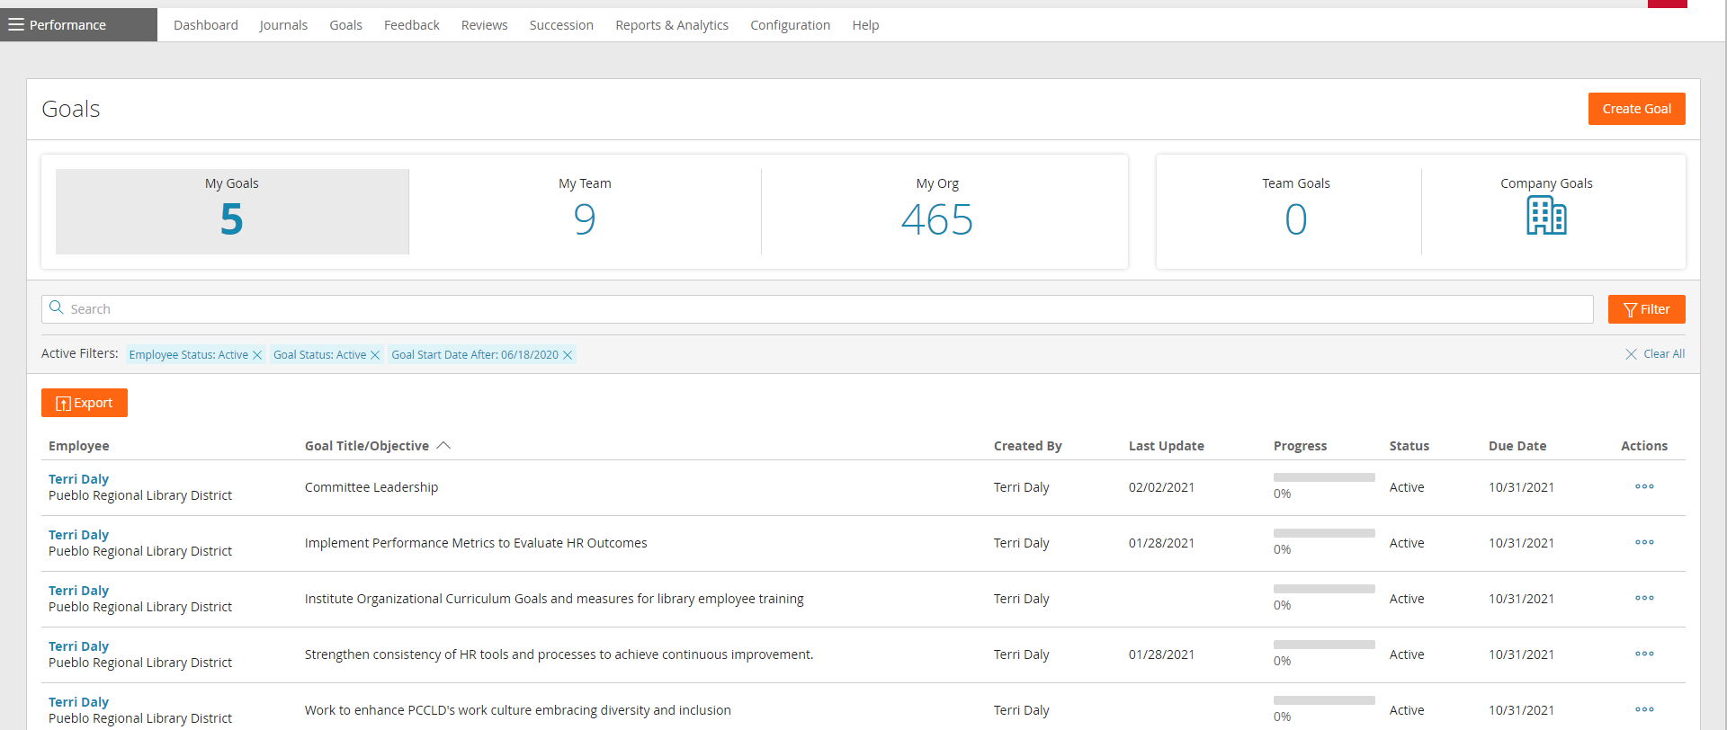
2025 - Adding Goals – How To
3. Select Create Goal

Slide 3
2025 - Adding Goals – How To
4. Select Individual
5. Select Smart/MBO
MBO – Management by Objectives
OKR- Organization Key Result

Slide 4
2025 - Adding Goals – How To
6. Complete Goal Title and Goal Description
7. Goal Period = 2025 Smart Goals
8. Goal Dates – the Start Date and Due Date should populate, but if they don’t, you will need to enter the dates – 11/1/2024 – 10/31/2025.

Slide 5
2025 - Adding Goals – How To
9. Goal Category: 2025 SMART Goals
10. Goal Measurement: You can select from complete/incomplete, percentage, or number
11. Keywords – Not required to complete. If you would like to, you can enter any necessary key words like “shelf rate” or “programming”, etc.

Slide 6
2025 - Adding Goals – How To
12. Company Alignment: You can choose to align each of the goals with either a PCCLD Key Result or a PCCLD 2025 Annual Plan Objective.
13. Select “SAVE.”

Slide 7
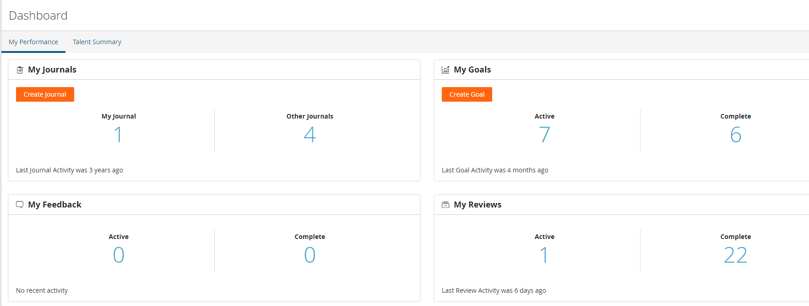
2025 – Editing or Deleting Your Own Goals
For Employees

Slide 8
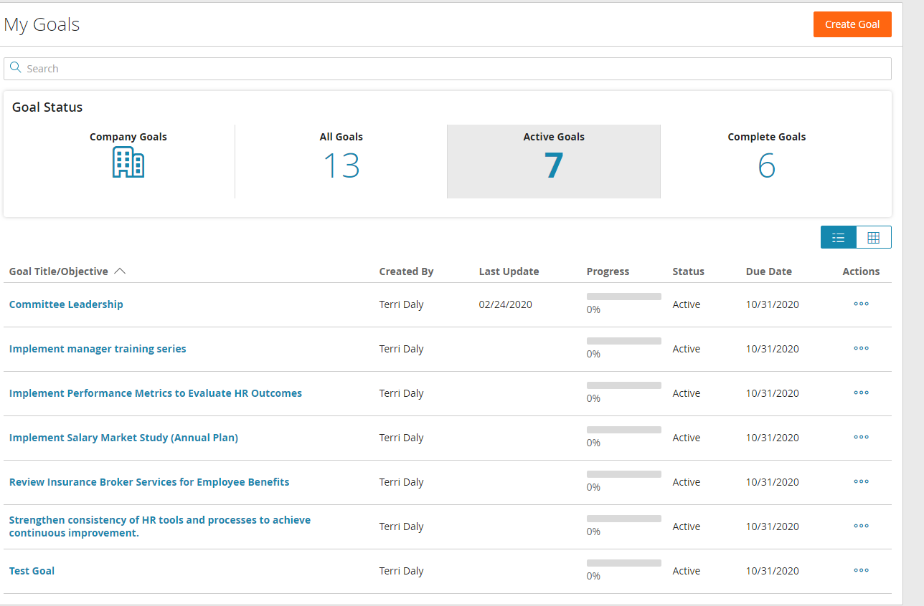
2025 – Editing or Deleting Goals
Make sure you are on Active Goals.
Select the 3 dots under Actions.
Pop Up – You can Update (Edit), Copy the goal, or Delete

Slide 9
2025 – Editing or Deleting Goals
Select Actions again, then you will get the same drop down menu
To Edit -Select Update
To Delete – Select Delete
NOTE: The system will not allow you to delete a goal if it is has already filtered to one of your reviews. If you still want to delete, please contact Terri Daly in Human Resources.

