Slide 1
Circulating Items
Finding, Checking Out, Checking In, and Fines

Slide 2
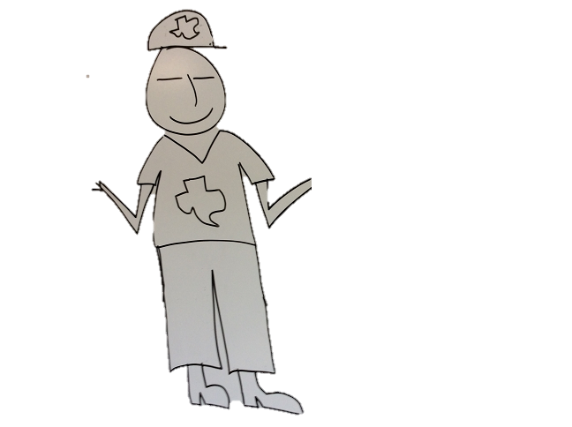
Can you help me find Walker Texas Ranger?

Slide 3
The Reference Interview
Possible Questions to Ask:
Do you need it immediately?
Yes, it’s an emergency!
Do you have a Blu Ray player?
What’s that?
Do you have internet at home?
Yes, on my cell phone.

Slide 4
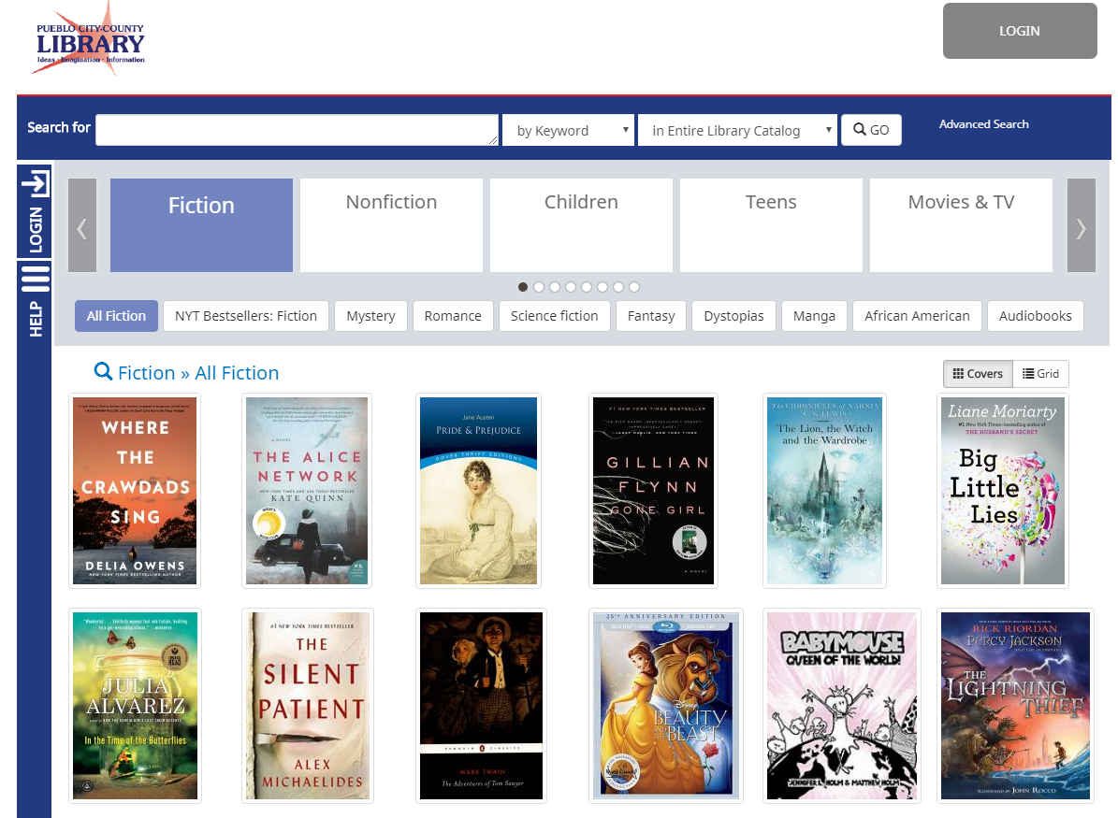
OPAC-Online Public Access Catalog
https://catalog.pueblolibrary.org/

Slide 5
LOGIN to Access Account

Slide 6
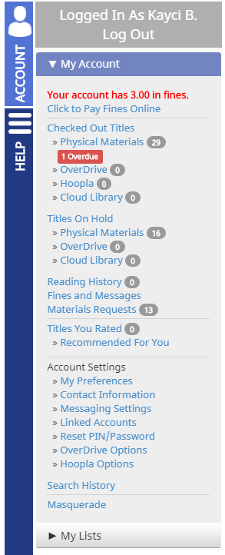
Masquerade - to access and place holds on Customer’s account
Login with your staff account.
At the bottom of My Account click the option to masquerade.
Masquerade allows you to put in customer’s card #, but won’t need their PIN.
Then you can place holds for the customer

Slide 7
Masquerade Mode

Slide 8
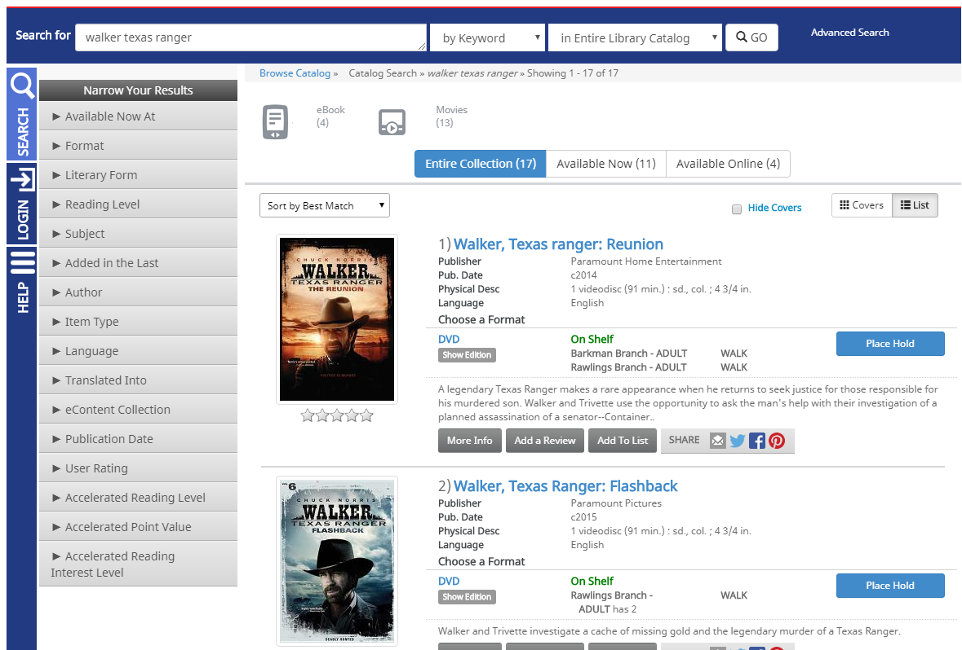
Discovery

Slide 9
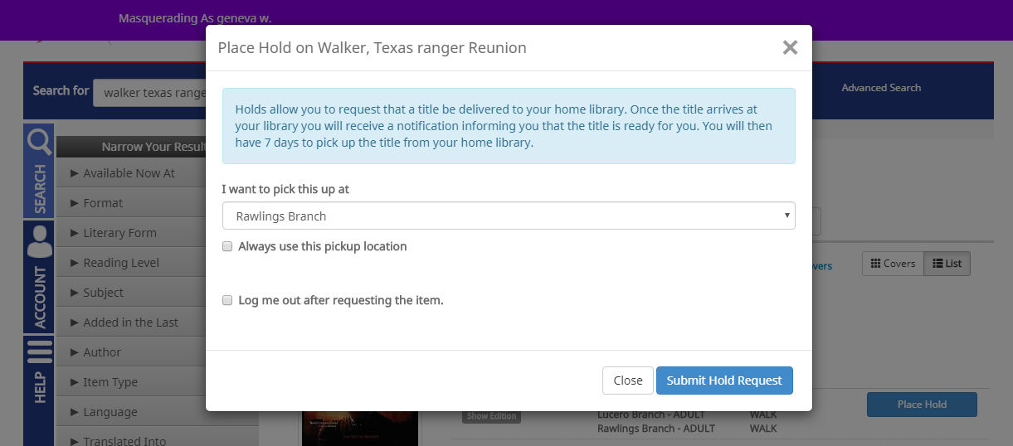
Place Hold
Click Place Hold on item wanted and follow prompts.

Slide 10
In-Transit Delivery between branches
If people want that day they may want to go to branch where it is at.
Call that branch to make sure item is there before sending customer (catalog isn’t always right!)
If customer can wait tell them they will be notified
If checked-in transit items will typically be there 2 business days.

Slide 11
Log Out
Make sure to log out, and or remind customer to log out when done searching.
End Masquerading when done helping customer.

Slide 12
Yee Haw! Now what?

Slide 13
Let me help you check it out!

Slide 14
Scan your card, and choose an option.

Slide 15
Place multiple items in check out box.

Slide 16
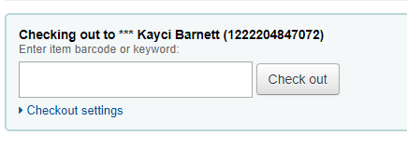
Checking Out in Koha

Slide 17
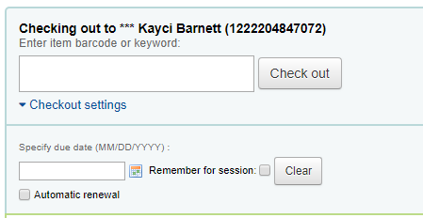
Specify Due Date

Slide 18
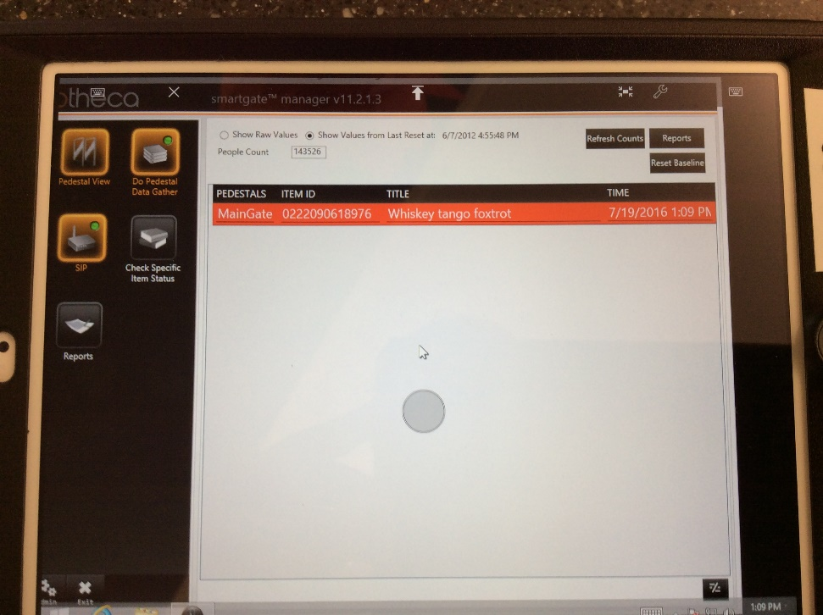
Use Pad to Deactivate Security
Using the RFID pad to checkout ensures the security is deactivated and the gates won’t beep.
If the gates beep call the customer back and check the IPAD
Red it’s not checked out
Green it is checked out

Slide 19
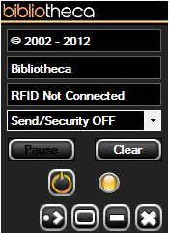
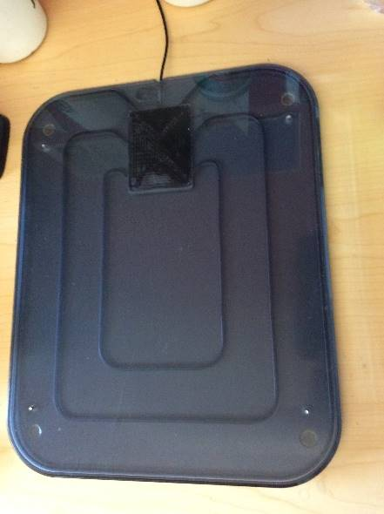
Using RFID Pad
Open bibliotheca Circ Manager and put on Send Security Off
Put cursor in field
Place item on pad

Slide 20
Man, that show is awesome.
Time to return it. What should I do?

Slide 21
Let me help you return it!
Automatic
Material
Handling

Slide 22
Weeeeeeee!

Slide 23
Sorts into Bins

Slide 24
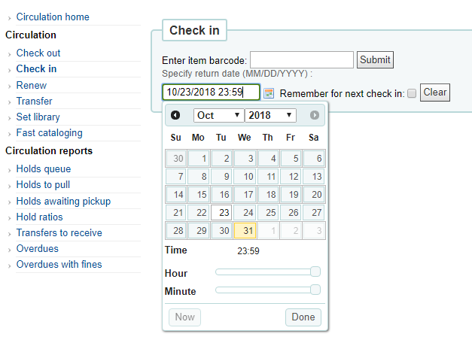
Checking in Koha
Means it’s staying at your location

Slide 25
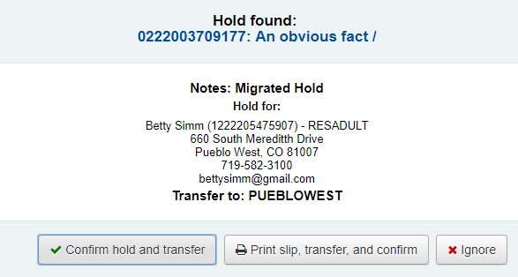
Transferring and Holds
Check the Route/Transit to for the status of the returned item.
Discard/Withdrawn – weed the item
Cataloging, Techsvcs, or No/error in the Record – send to TS
Holds

Slide 26
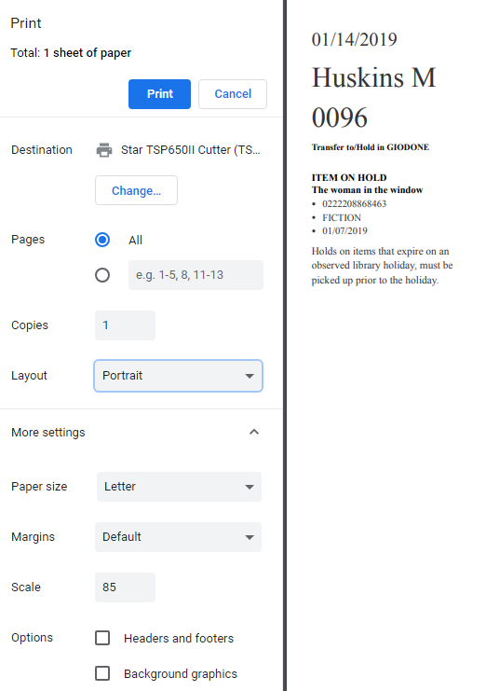
Hold Slip Printing Dialog Box
Make sure set to receipt printer
Set to Portrait
Scale could be set up to 100
Make sure Header and footer not
checked

Slide 27
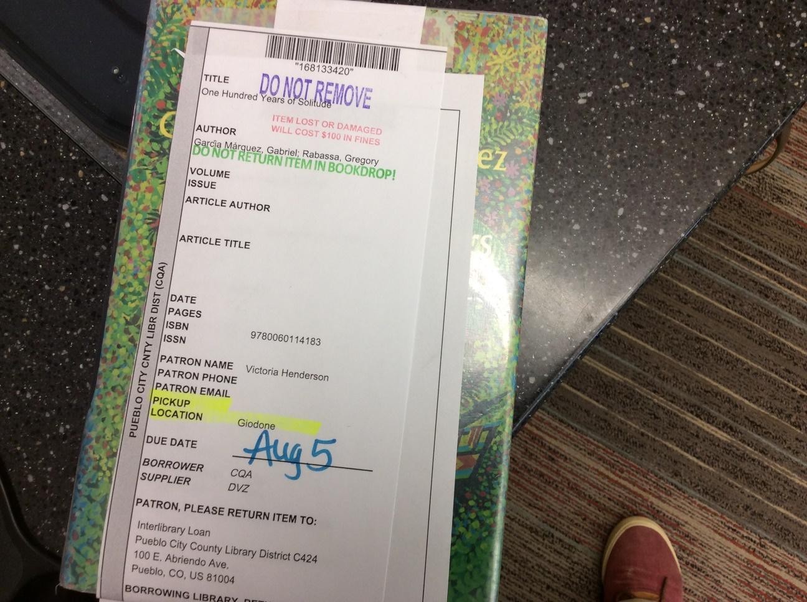
Interlibrary Loan
1. Write on the label “Returned”
2. Send to Circ at Rawlings
3. If at Rawlings, place the item on the ILL shelf in the Circulation work area.
When items are not picked up, send them to Circ with “Not Picked Up” written on the label.

Slide 28
Tablet & Hotspots Special Handling
Checking Out- Make sure is working, good condition, has charger, must be Adult card.
If late $5/day up to $50
Returns– Turn on Device, check for damage, make sure it has the charger

Slide 29
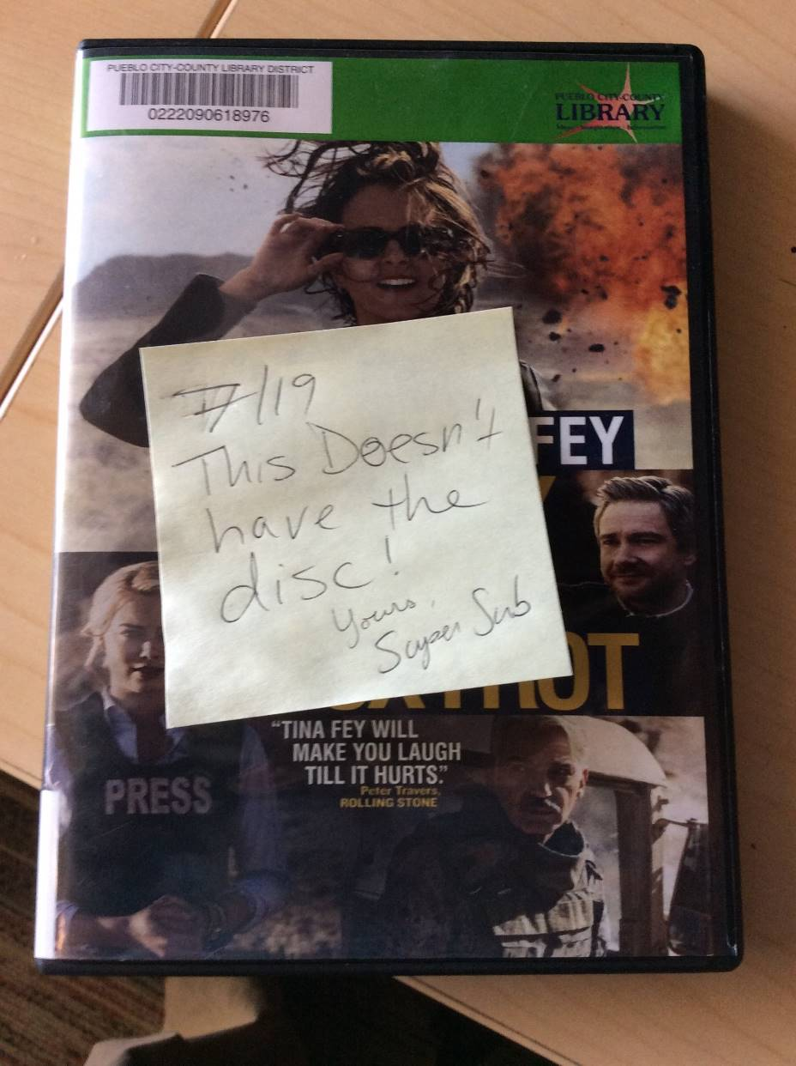
Damaged, Incomplete, or Unknown
If a customer reports damage, or if missing the disc. Put a post it on the item and leave for staff.

Slide 30
Missing Disc Pop Up Message

Slide 31
Renewing
Customers can’t renew themselves, it’s set for automatic renewal, but staff can do it.
2. Click the boxes of each item to renew or select all
3. Can set the renewal date if needed
4. Click Renew selected Items Button
1.Click the override renewal button at bottom of checkouts (this will get you boxes under renewal column)

Slide 32
Claims Return
Customer’s sometimes have items on their account that they “claimed to have returned” Follow these steps...
Ask “Which branch do you think you returned the item to”
If they say it was the branch you’re at, go check the shelf for the item making sure it’s the same copy (i.e. check the barcode)
if found on your shelf, make sure to change the check in date in Koha so it’s before the due date utilizing the check in settings.
If not found and not late, renew items and ask them to check one more time
If the item can’t be found, mark it claims return in KOHA – follow link for a video demo. https://drive.google.com/file/d/1K-KoMbT4R_zDfVDLV7xvwwNjUMiRvt3J/view?usp=sharing

Slide 33
Guess I might owe a little,
since it was a bit late. You take credit?

Slide 34
Fines & Fees –
Fines and Fees can be a sore spot for customers, but
being empathetic can help ease their pain.
Thank them for supporting the library by paying their fines.
The following slides explain how customers get fines, and what to do if they don’t want to pay them.

Slide 35
Overdue Fees
We do not charge late fees!
If the item is lost, they are charged the price to the item and a $5 processing fee.
Devices are $5 per day
ConnectEd cards do not have fines.

Slide 36
How to pay fines (over $2) on the Self Check with a Credit Card
2. Pay Charges
3. Choose Payment Method
4. Pay
5.Choose Full Amount, or type in amount to pay, then OK

Slide 37
6. Give the Pillsbury Dough Boy a tickle (touch the CC screen).
7. Use the stylus, and touch YES.
Magnetic strip faces up, and swipe right to left, or use chip.
9. Sign using the stylus.

Slide 38
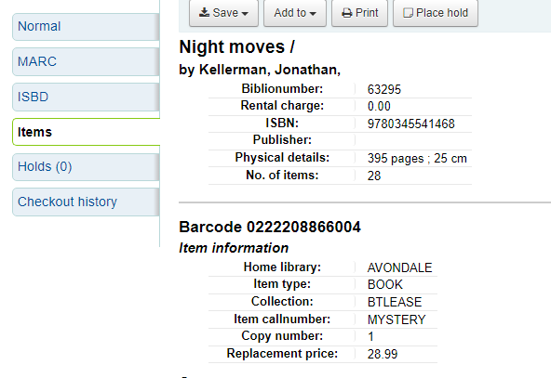
Lost or Damaged Items
If a customer loses an item they must pay the price of the item, plus a $5 processing fee.

Slide 39
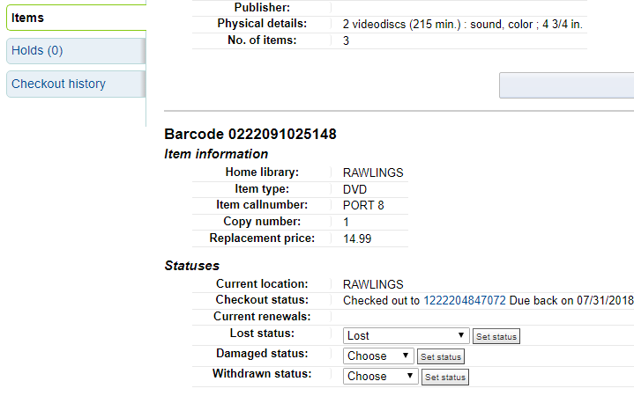
To Bill Customer set item to Lost

Slide 40
Replacement Item
Customer can provide a BRAND NEW copy of the exact same thing.
Always follow the Replacement Item instructions located here http://portal.pueblolibrary.org/document/process-accepting-replacement-item

Slide 41
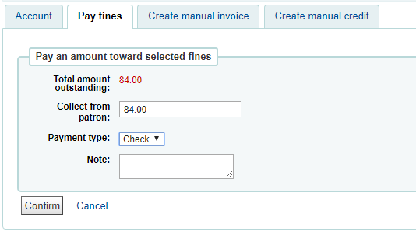
Paying Bills
Should be done in Checkout Station, but if paying with check must be done in Koha
There should be a carbon copy receipt book at all locations that you fill out whenever you take a check and include one of those copies with the check.

Slide 42
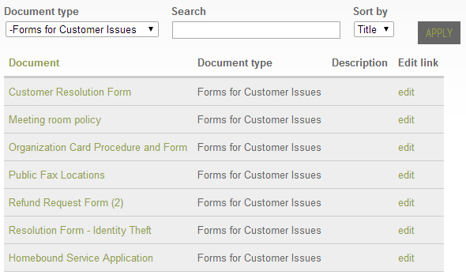
Refer all Requests for Fine Forgiveness
to Manager
If manager is unavailable, have them fill out customer resolution form, and give form to your Manager.

