Slide 1
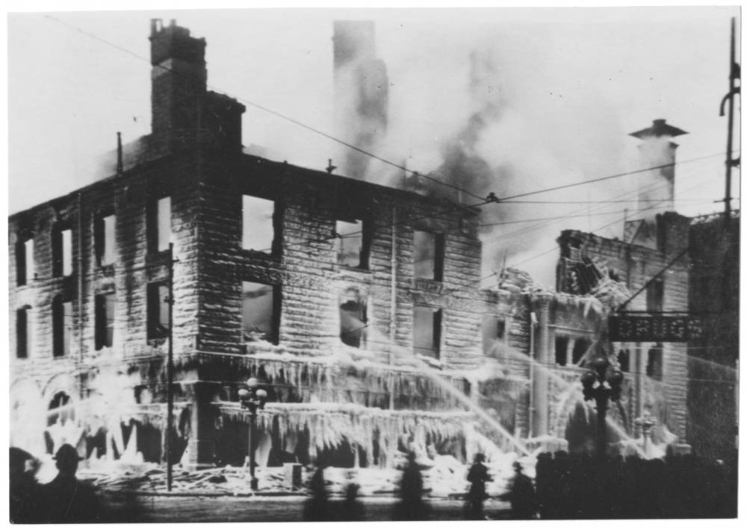
FIRE!
Evacuation from the Rawlings Library
Brought to you by the PCCLD Health and Safety Committee
“The Grand Opera House Fire”, March 01, 1922. From the PCCLD digital archives, https://cdm16620.contentdm.oclc.org/digital/collection/p16620coll9/id/17/rec/3

Slide 2
What to do if the fire alarm goes off?
Stop what you are doing.
Inform staff and the public in your general vicinity that everyone must leave the building due to the alarm.
If patrons do not want to leave, do not argue with them. Inform the PIC when you reach the rally point.
If the patron is unable to use the stairs to exit, guide them to the closest area of refuge and inform the PIC of their location when you reach the parking lot rally point. See areas of refuge in the next slide.
Exit the building using the closest emergency stairwell or door. Encourage others to follow you down the stairs.
Head to the rally point in the north-east corner of the main parking lot, across from the Joe Tomato deli.
Wait for the all clear from senior administration or the PIC
Return into the building through the staff entrance.

Slide 3
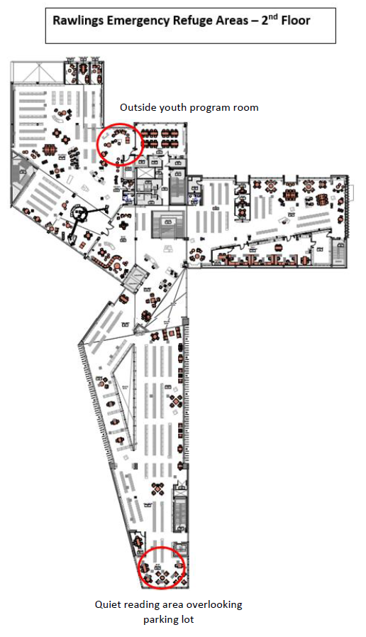
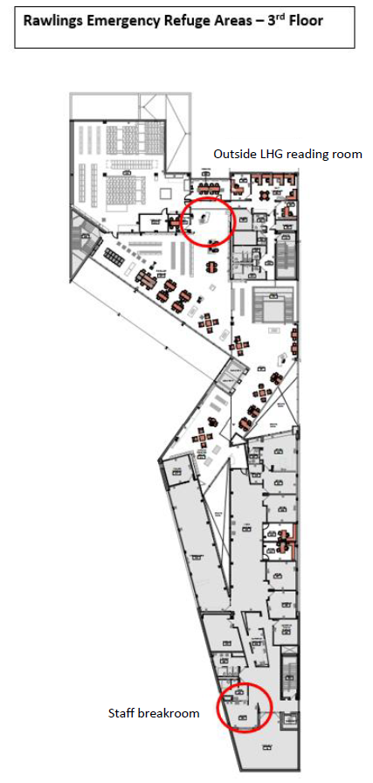
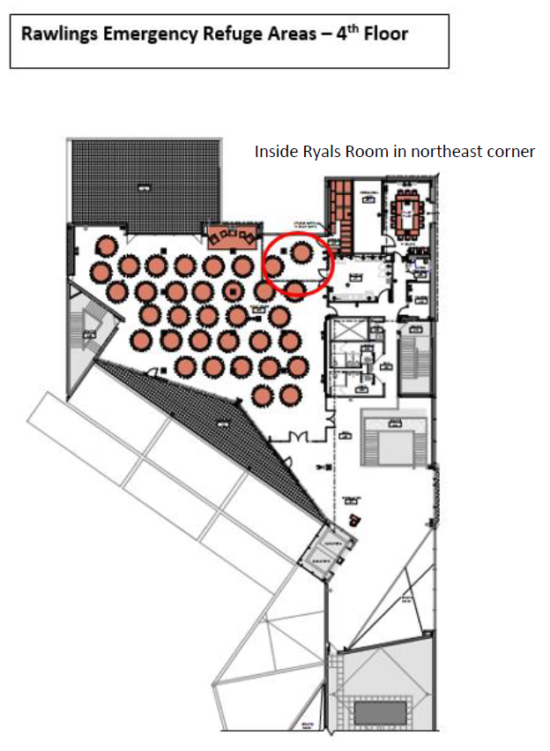
Areas of Refuge

Slide 4
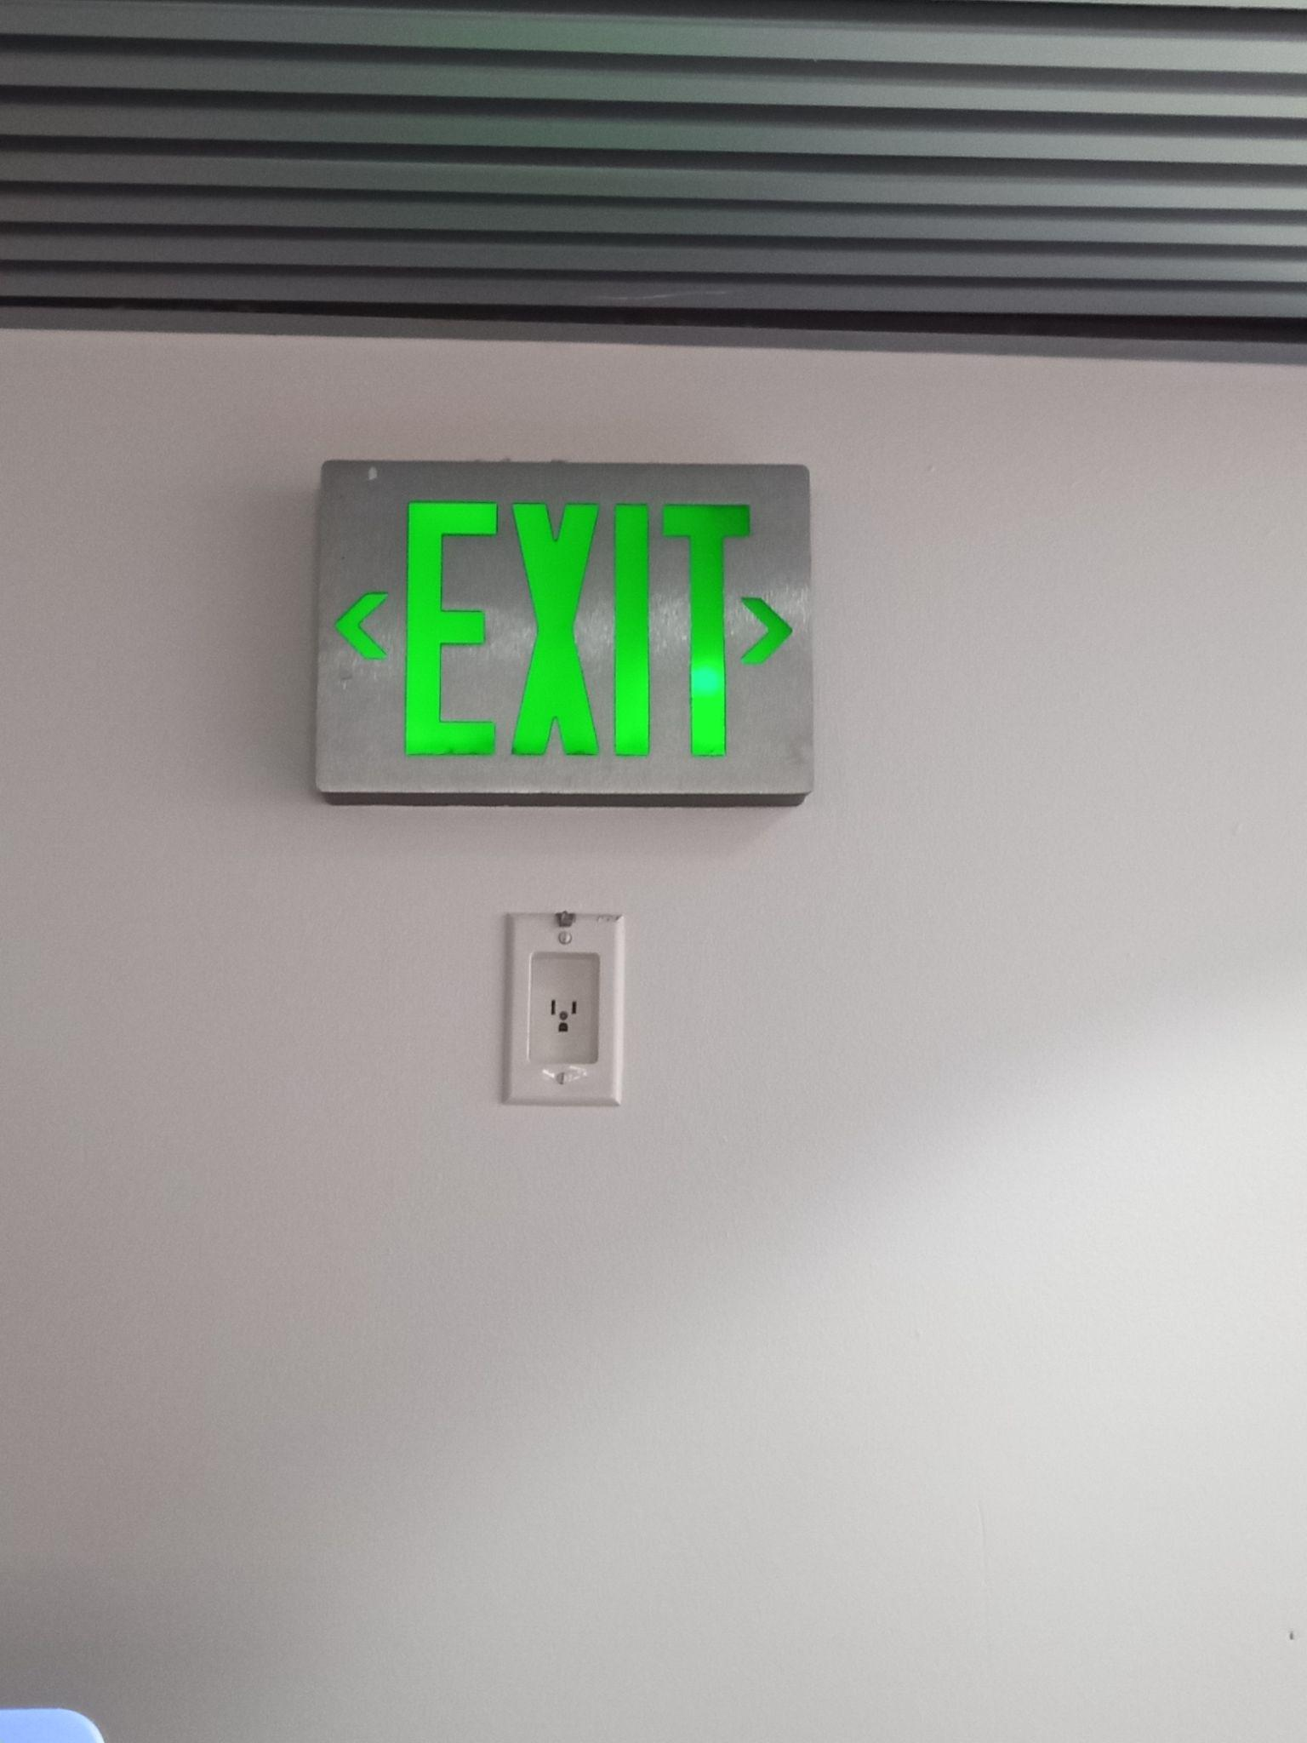
Where are the exits?
Familiarize yourself with your surroundings and know where the exits are. Exits are marked with the green light-up signs.

Slide 5
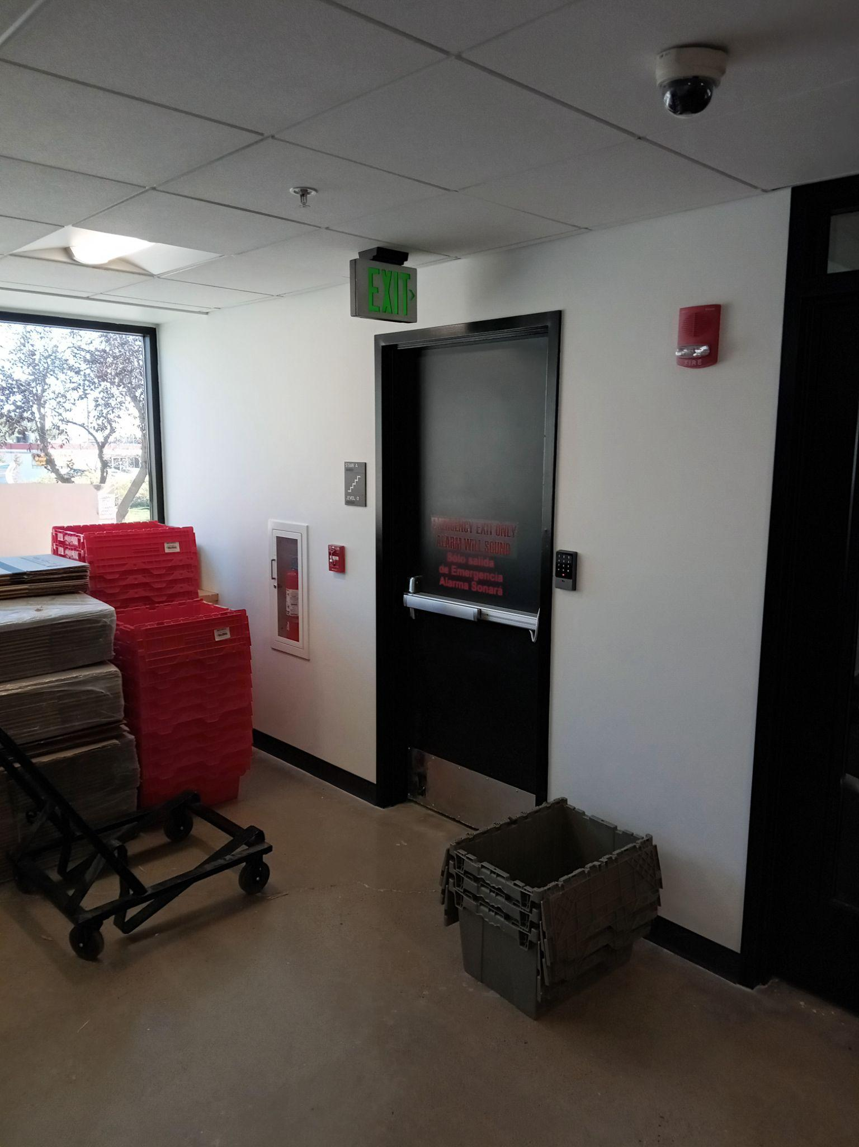
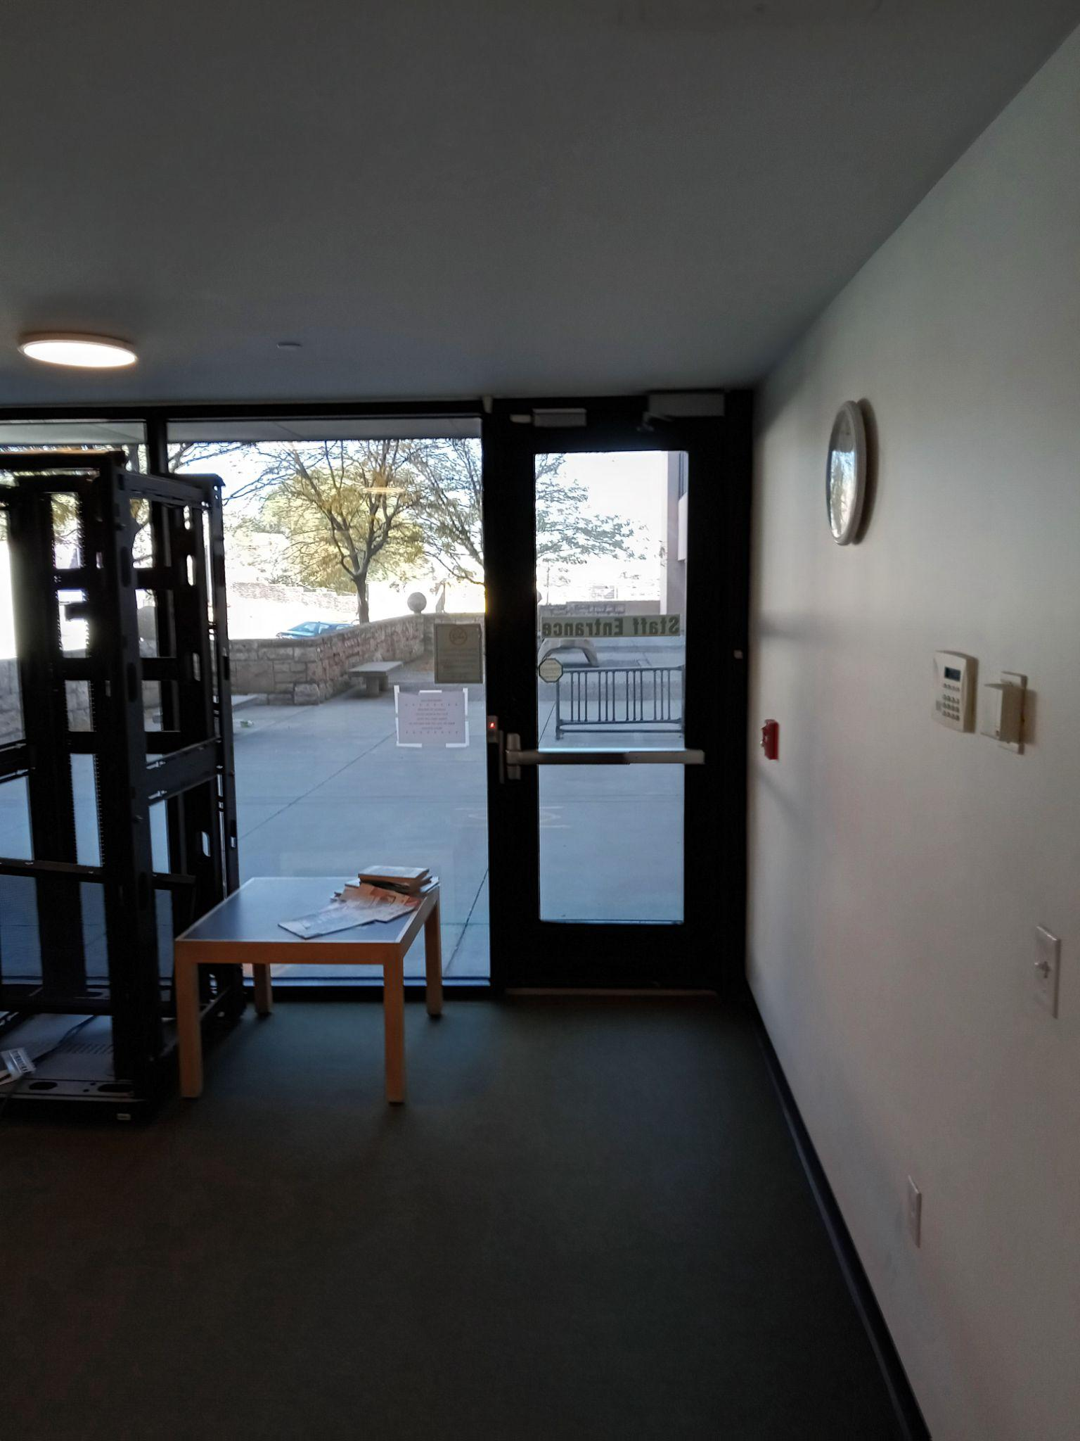
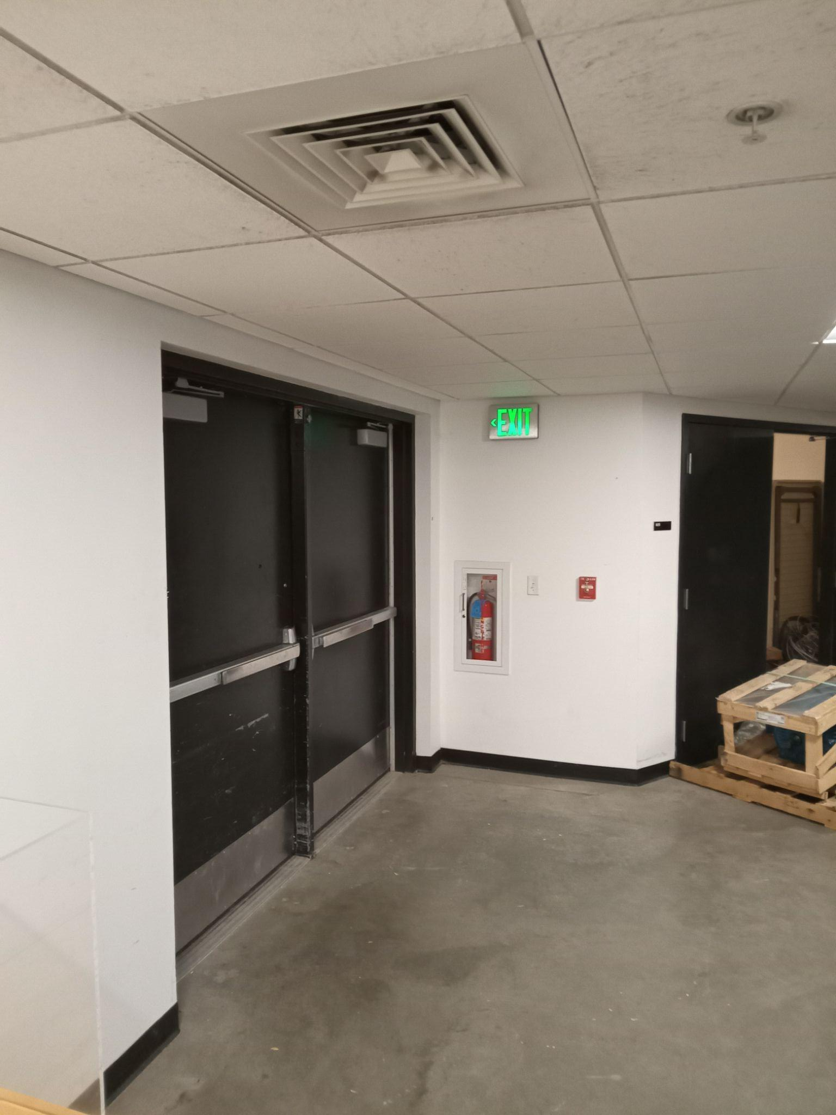
Basement Level
Break room exit
Double doors by the elevators
By the basement AMH

Slide 6
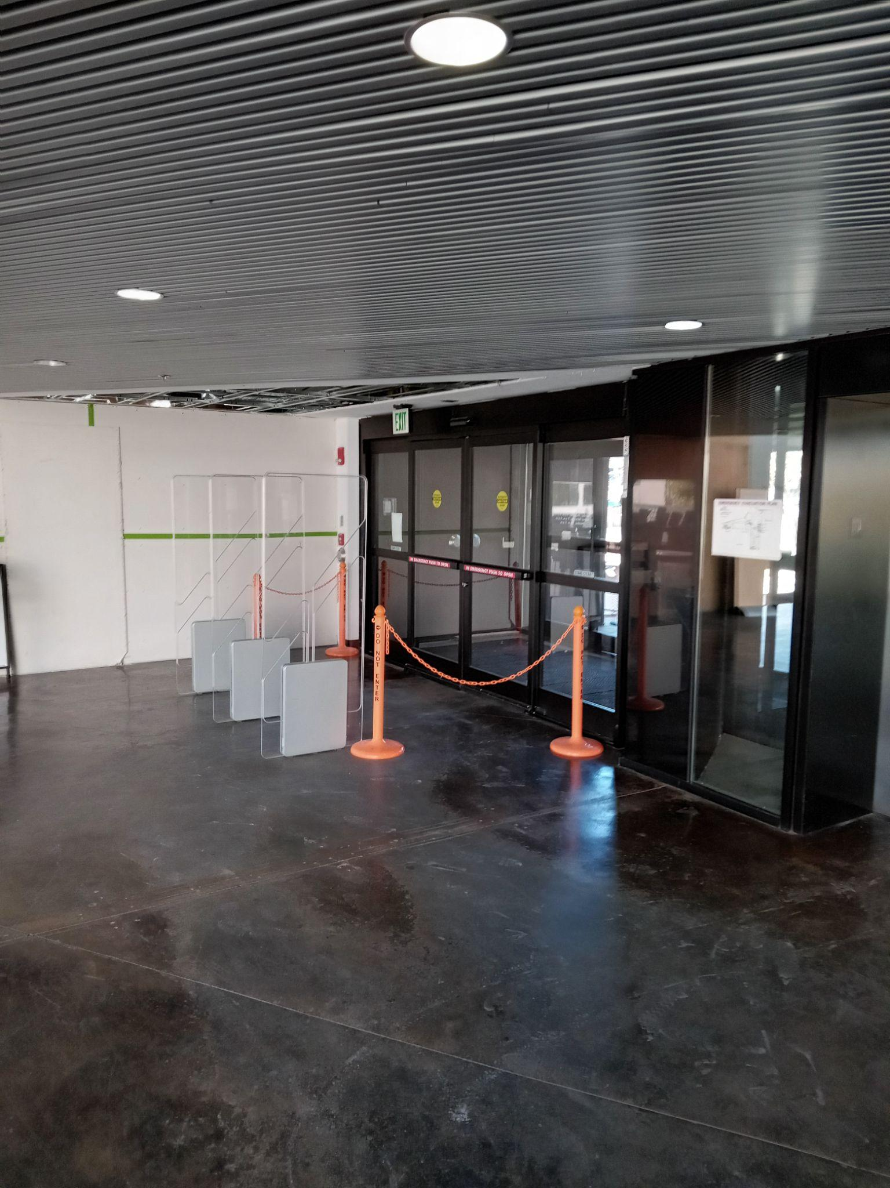
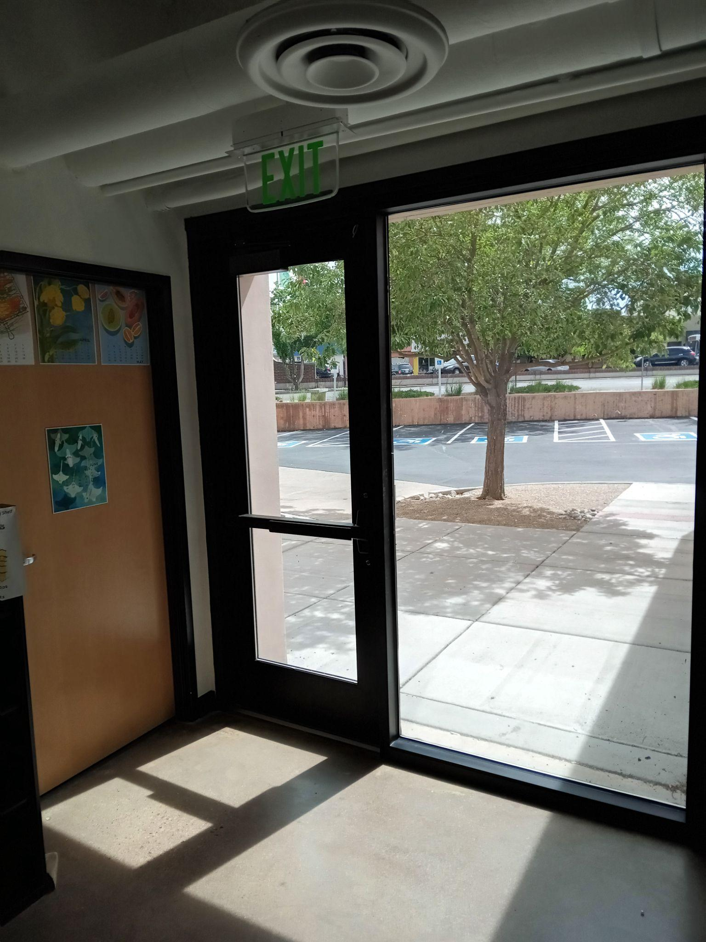
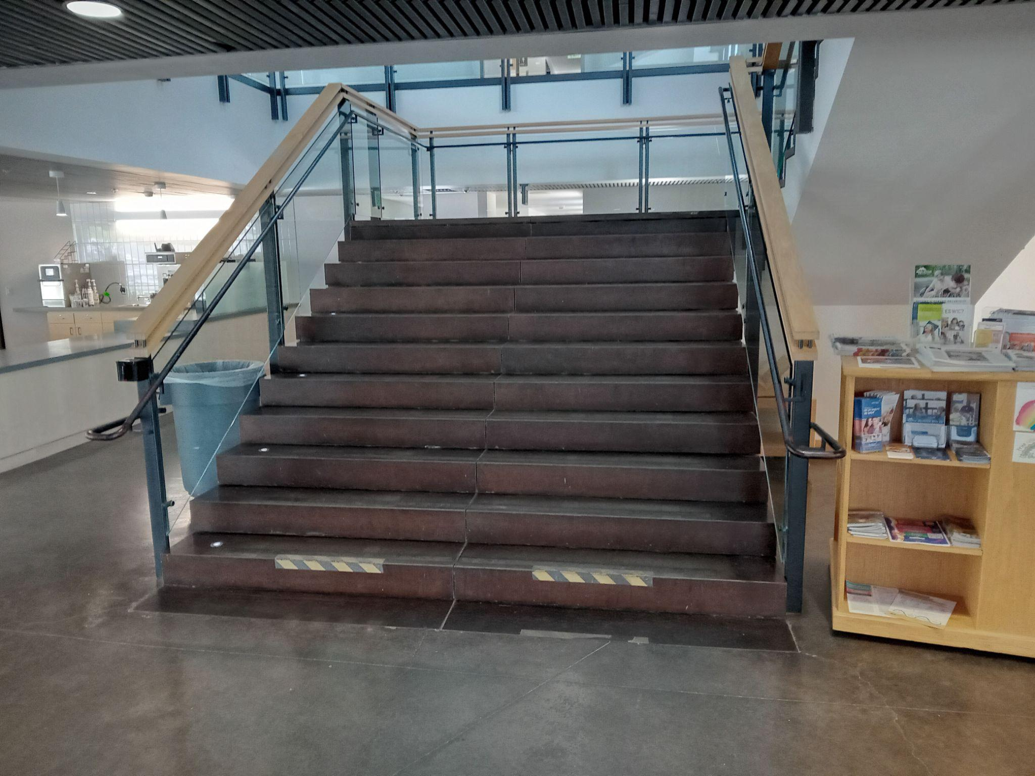
Egress at 1st floor
Main entrance/exit
Staff and patrons may use the main stairwell to leave the building.
Exterior door in Makerspace

Slide 7
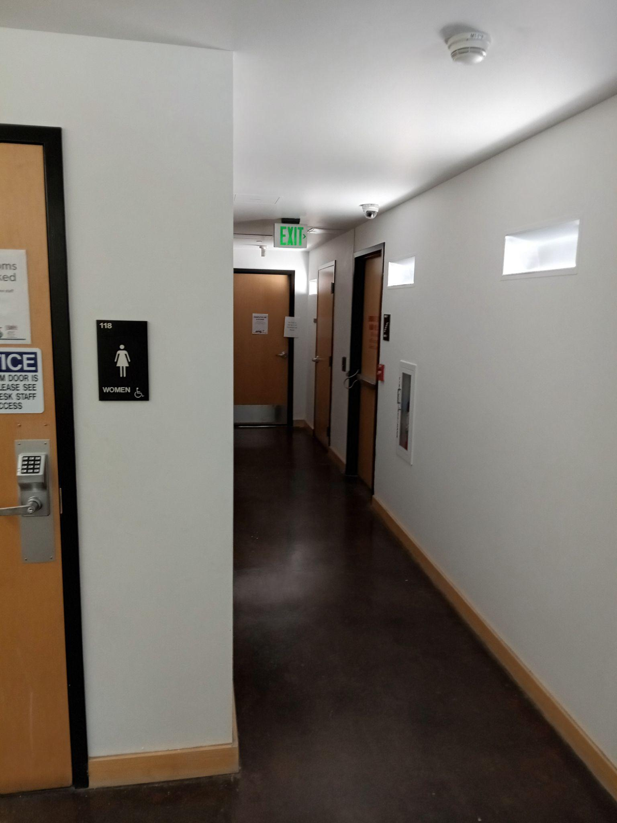
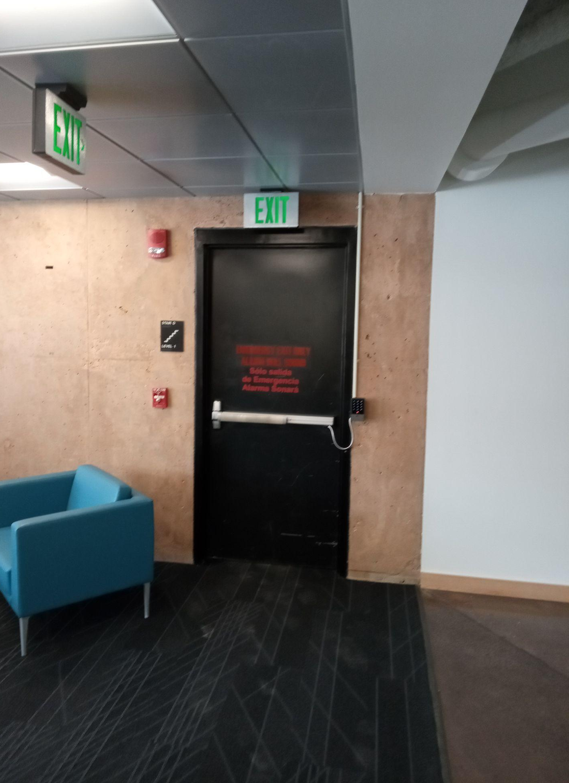
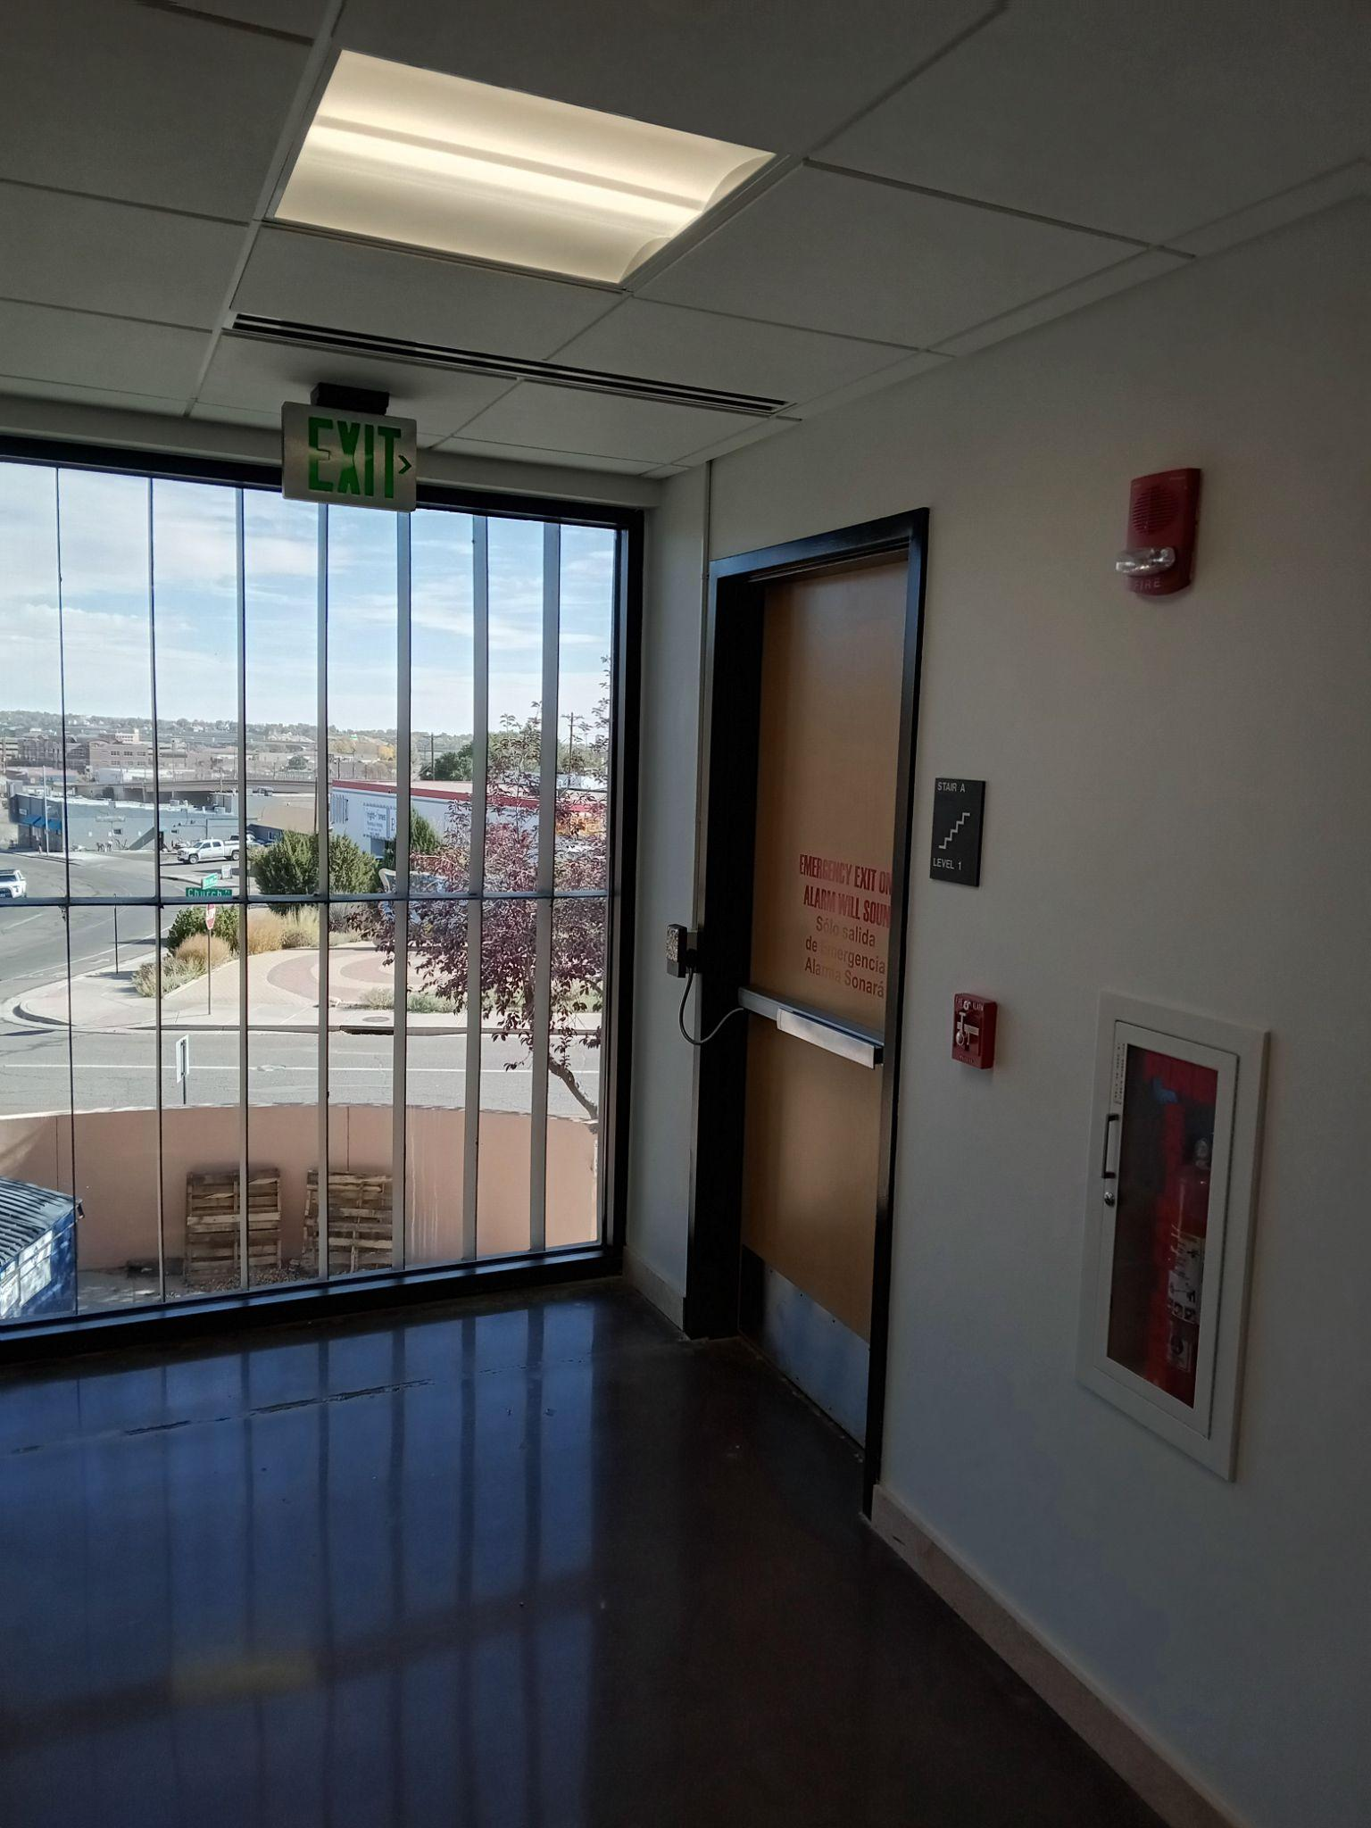
Doors to Emergency Stairwells - 1st floor
Down the women’s bathroom hall
By the FOL meeting room
Down the meeting room/security office hallway

Slide 8
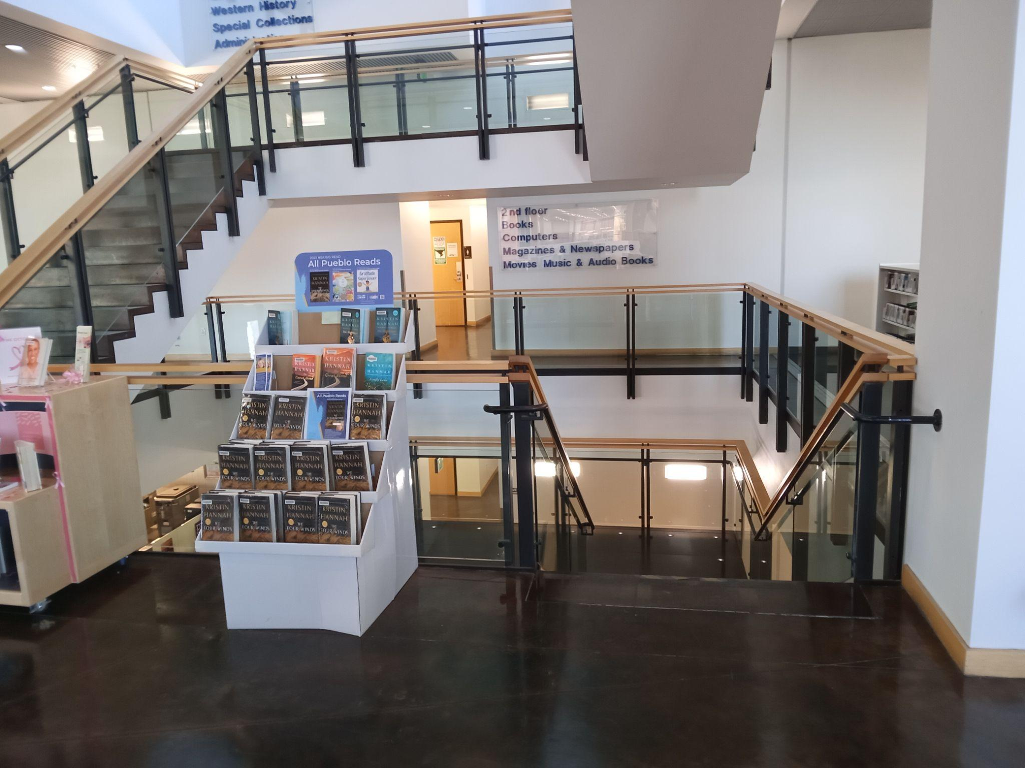
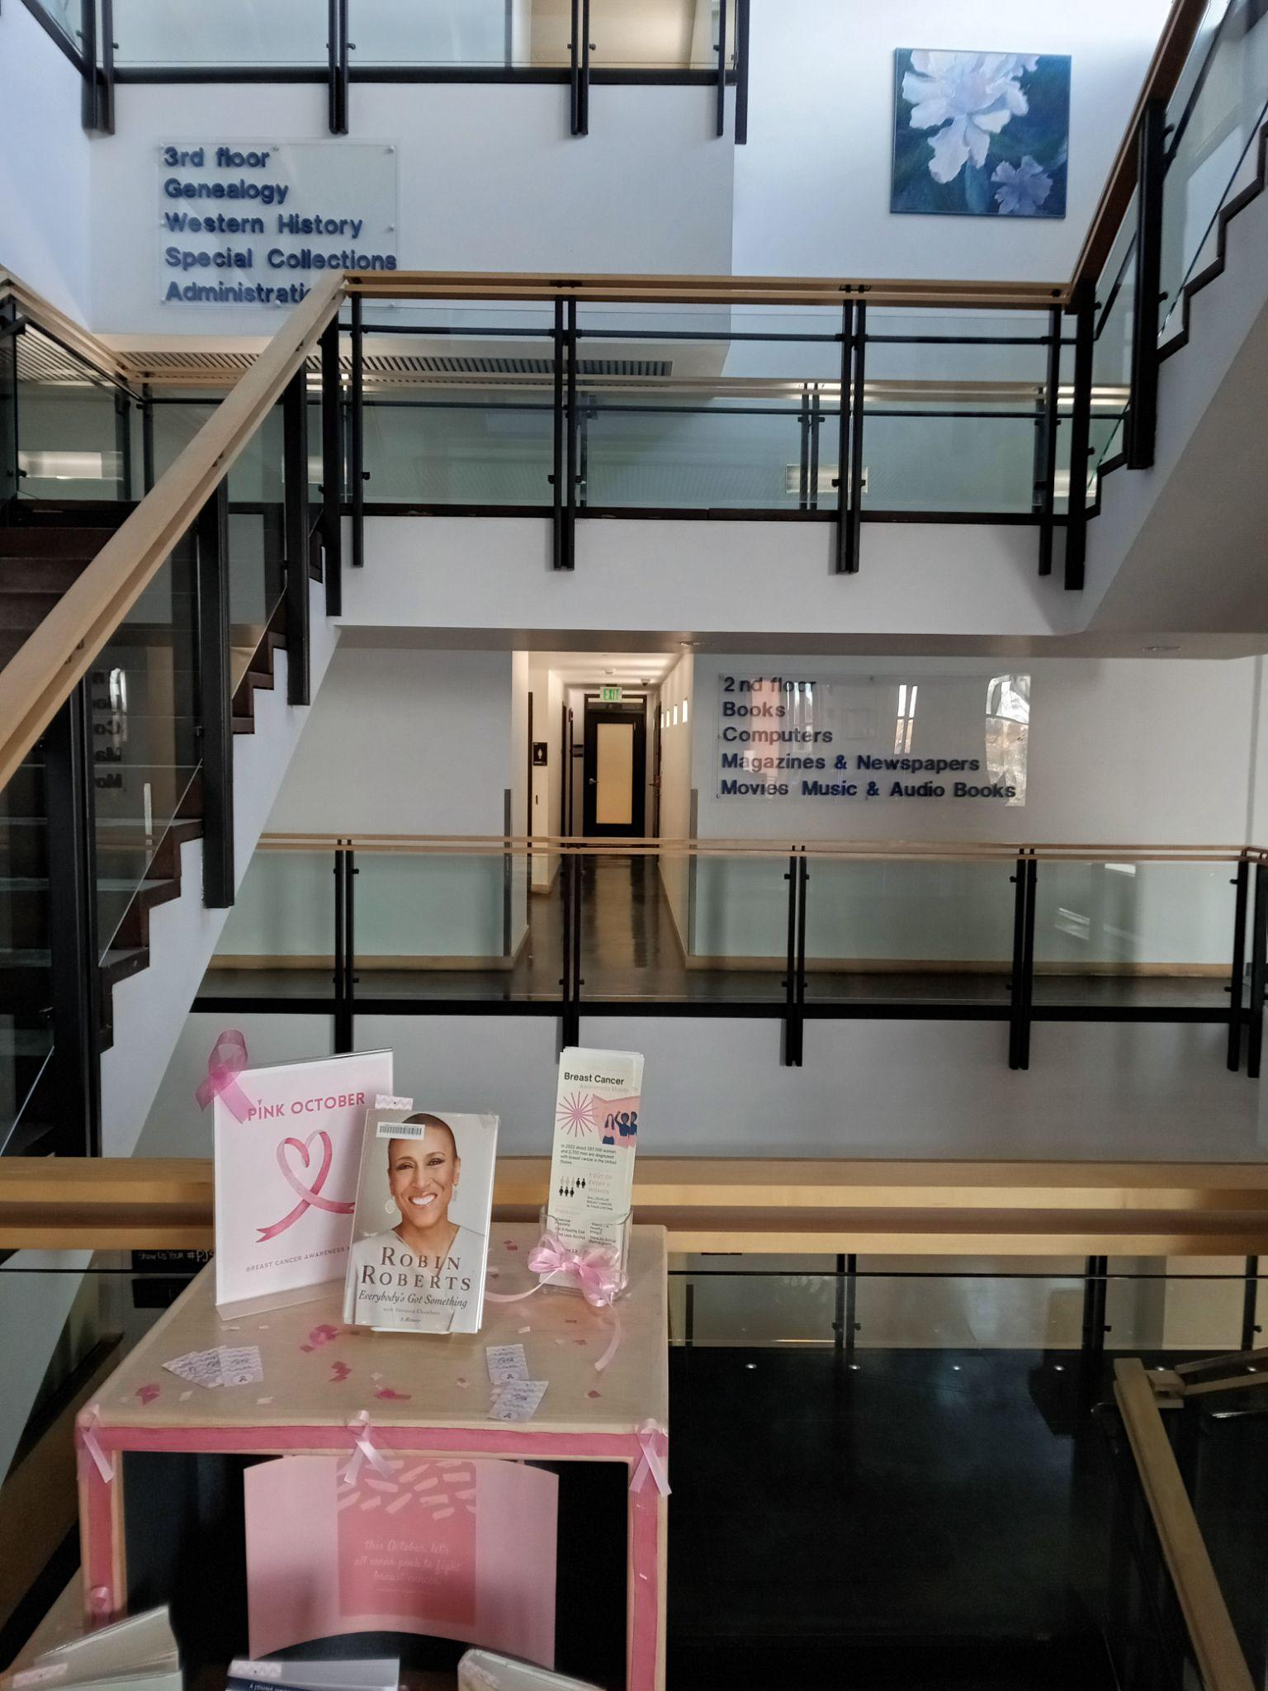
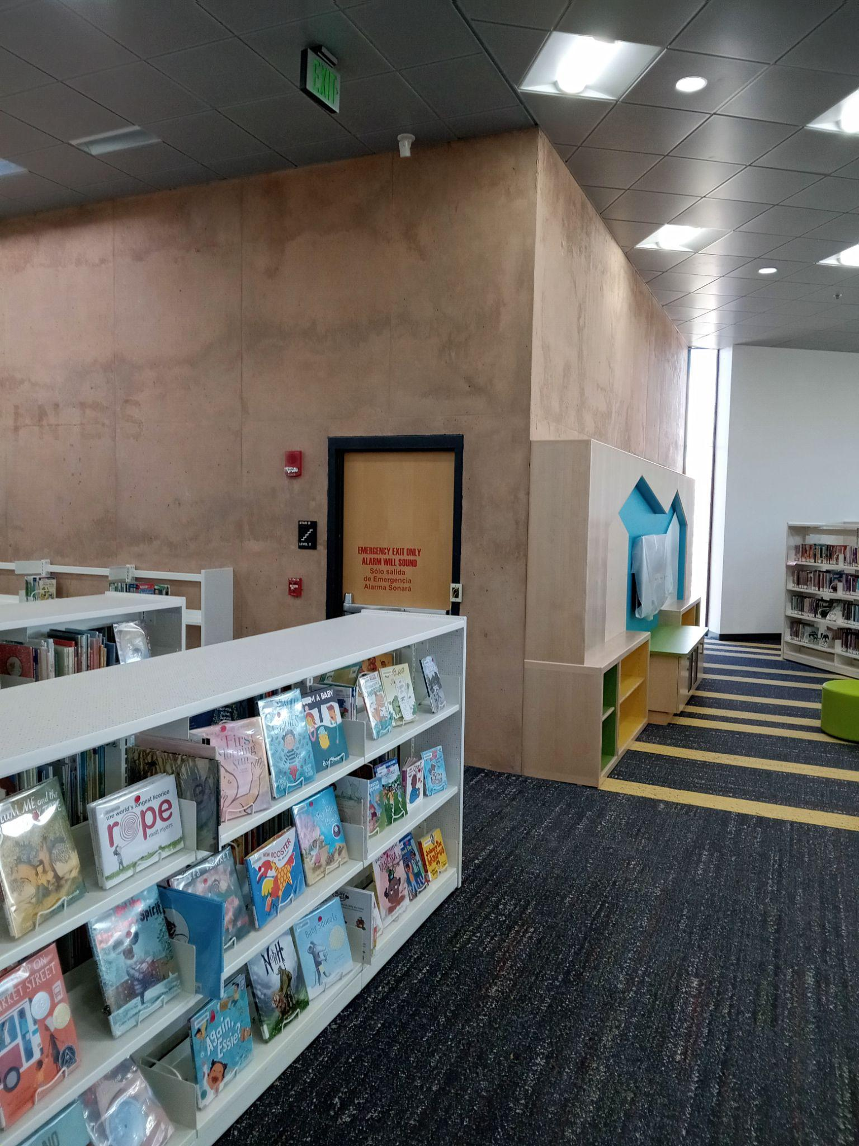
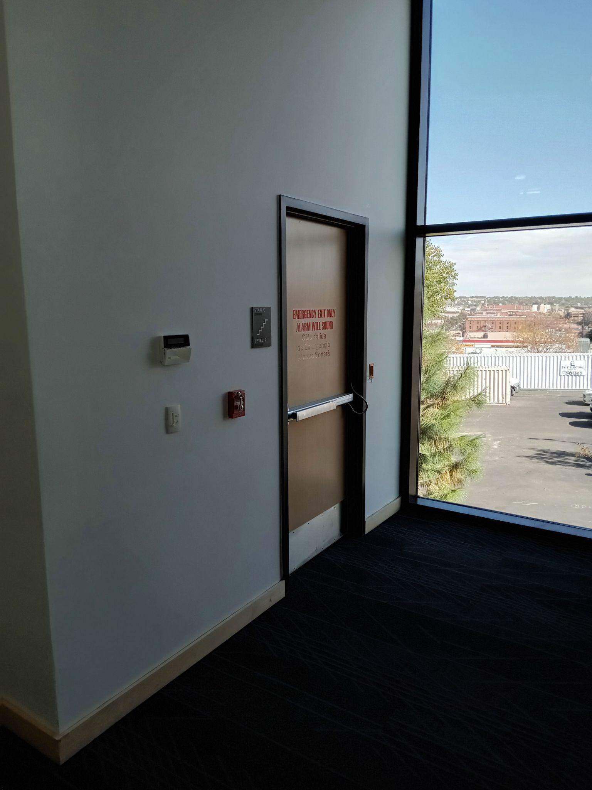
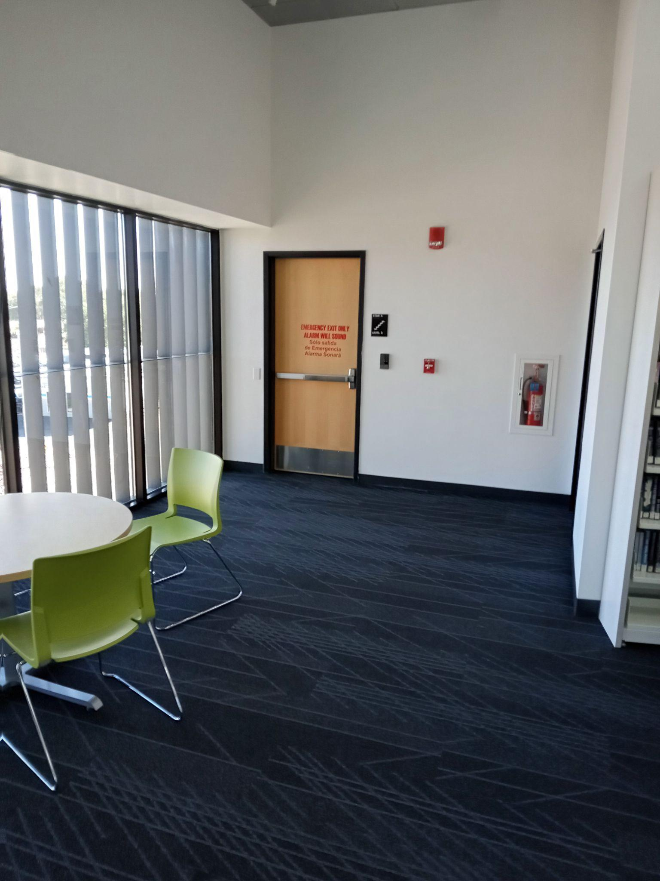
To Stairwells - 2nd floor
Main stairwell
Down the bathroom hall
By Youth book shelves
By the staff elevator
By the Teen area

Slide 9
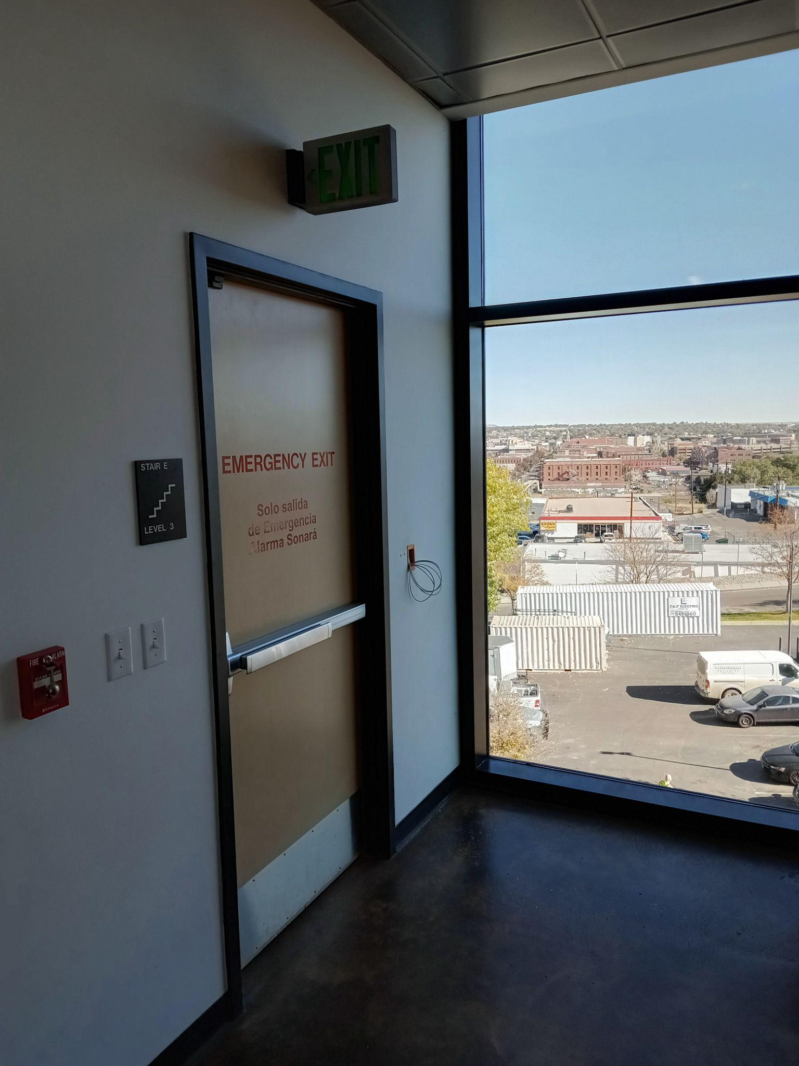
Administrative Offices - 3rd floor
Please exit through the stairwell. Do not go into the construction area.

Slide 10
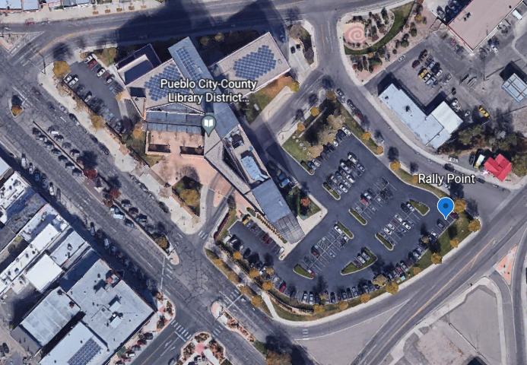
Where Am I Going?
Go to the northeast corner of the main parking lot. Across from the Joe Tomato deli.
Wait until you are cleared to reenter the building by senior administration, PIC, or Facilities, or Security staff. Enter through the staff entrance.
Do not leave the property unless authorized by your manager, PIC, or senior administrator.

Slide 11
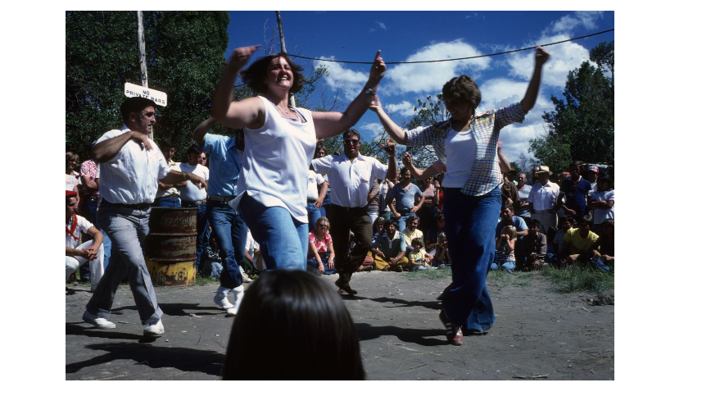
You Made It!
Breath a sigh of relief and enjoy the rest of your day.
“Dancing”, Basque Digital Collection, University of Nevada, Reno, University Libraries, University of Nevada, Reno Libraries Digital Collections,https://unr.dgicloud.com/islandora/object/basqcollcollection:3095

